Slide 1
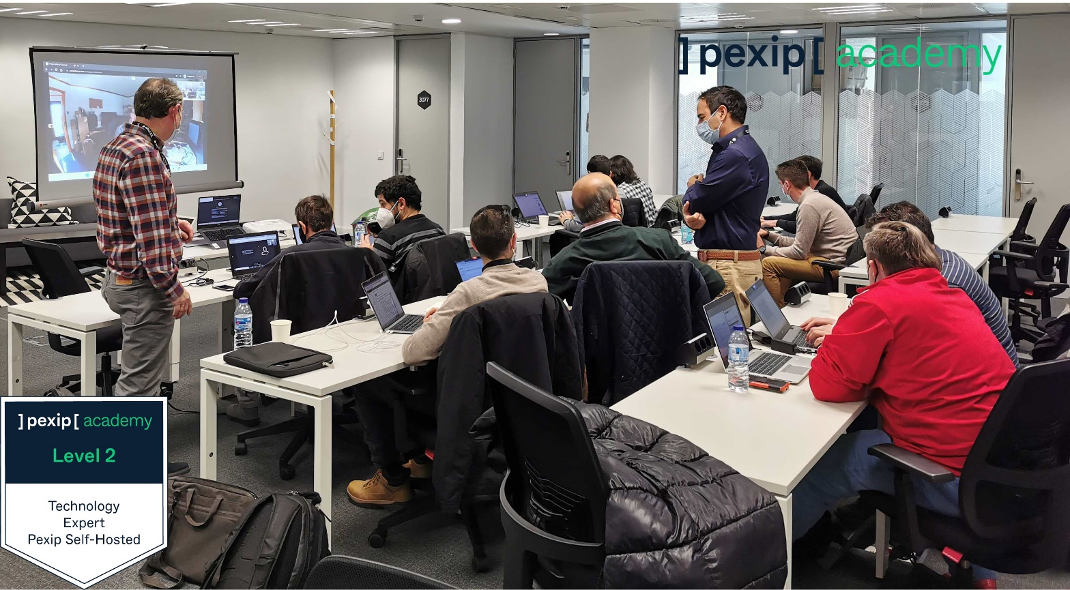
PexClinic
Alan O

Slide 2
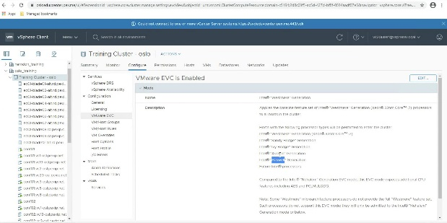


Agenda overview - eLearning, Clinic & Assessment
Theory & Assessment
eLearning Modules:
One Touch Join
On-line module
– approx. 2 hours
Clinic:
Live, virtual forum to discuss items from the course and cover some more theory behind installing and configuring Infinity.
– ½ Day
Final Assessment:
A series of on-line, self-paced quizzes to ensure understanding and that your learning objectives have been met
- approx. 2 hours

Slide 3
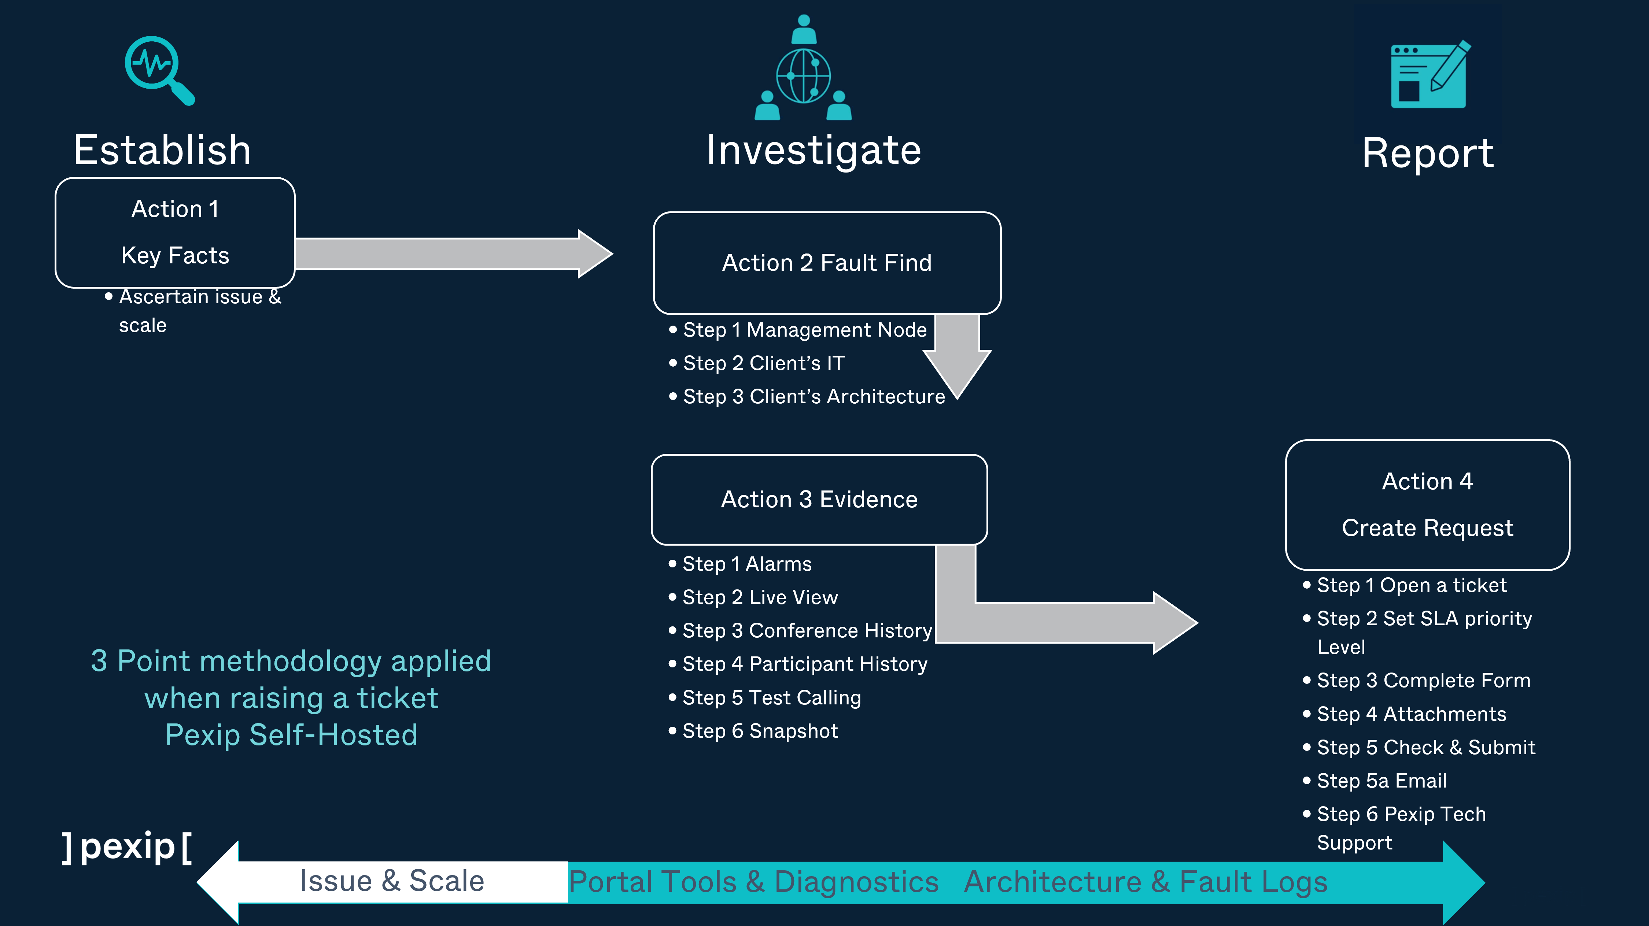
Pexip Self-Hosted. Rasing a support request using Pexip Troubleshooting triage methodology for diagnostics.

Slide 4
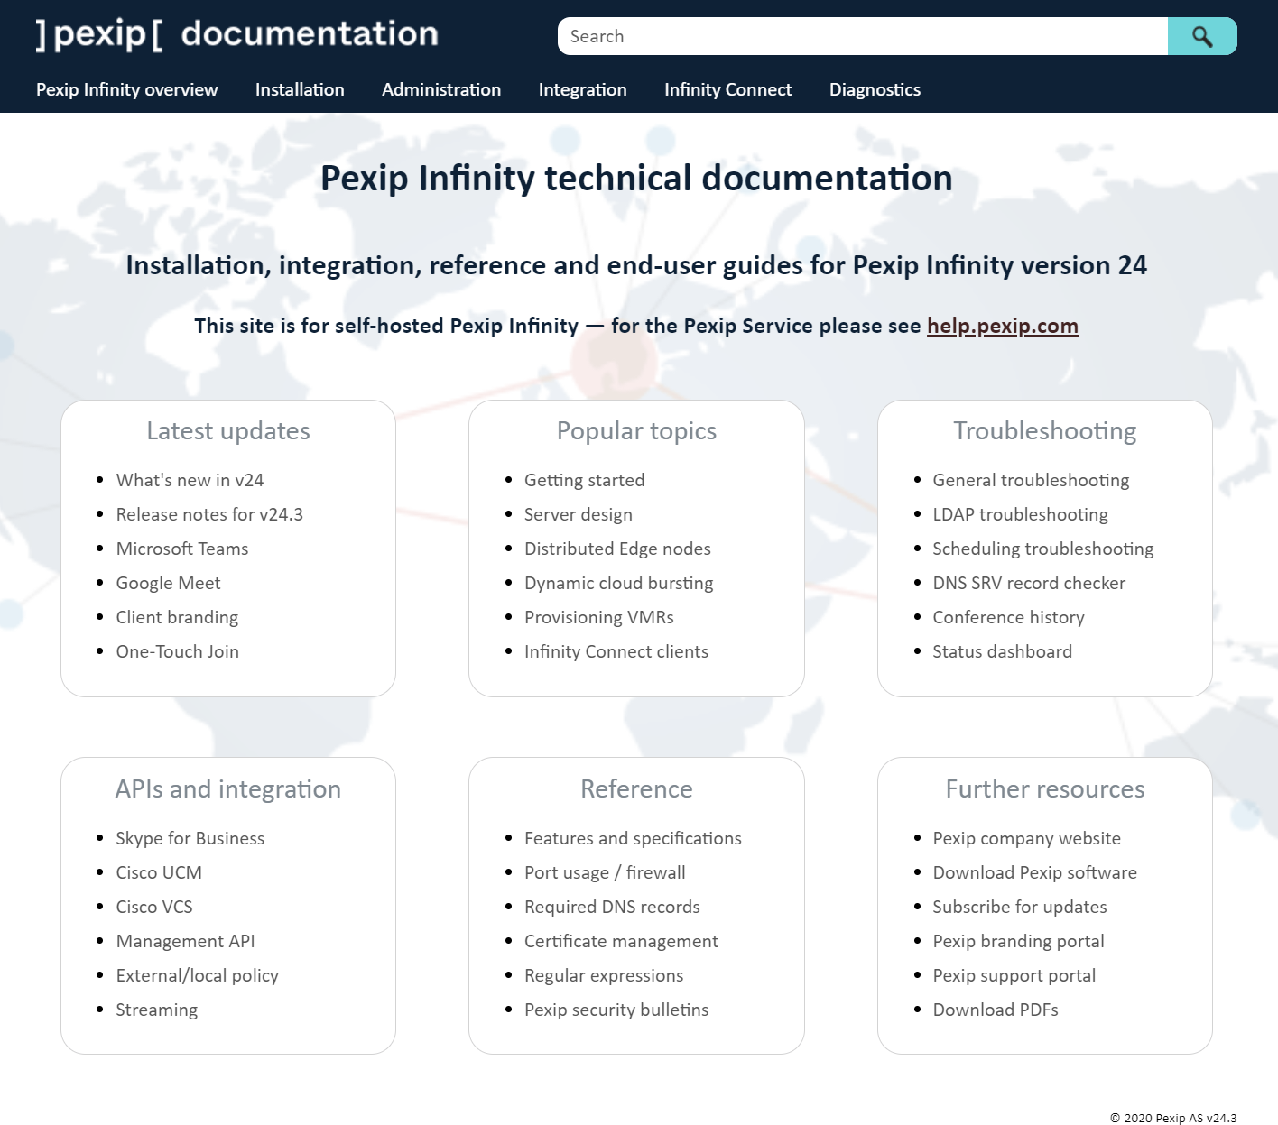
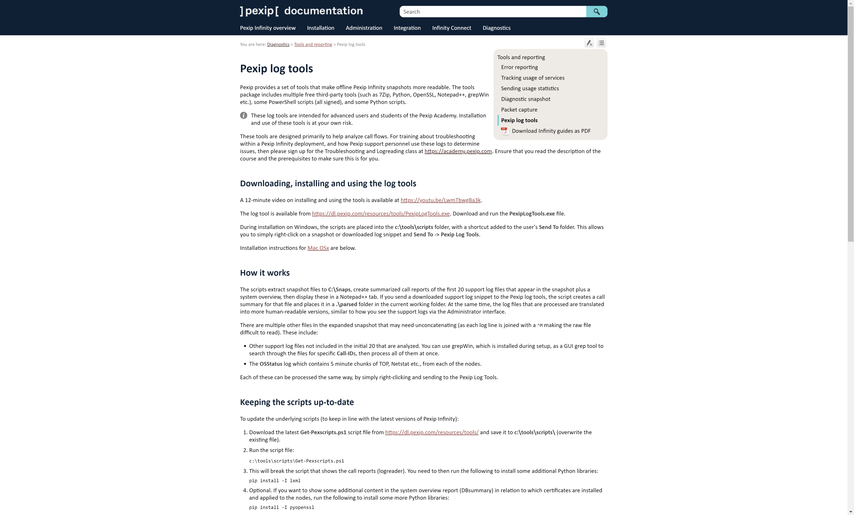
Tools for Partners
Online Documentation (docs.pexip.com)
Online Documentation (docs.pexip.com)
Pexip Infinity GUI
Pexip Log Tools
Partner Portal
Test Call Service (https://docs.pexip.com/admin/test_call_service.htm)
Pexip Log tools
Notes:
every Partner has a support toolkit to tap into at his / her fingertips.

Slide 5
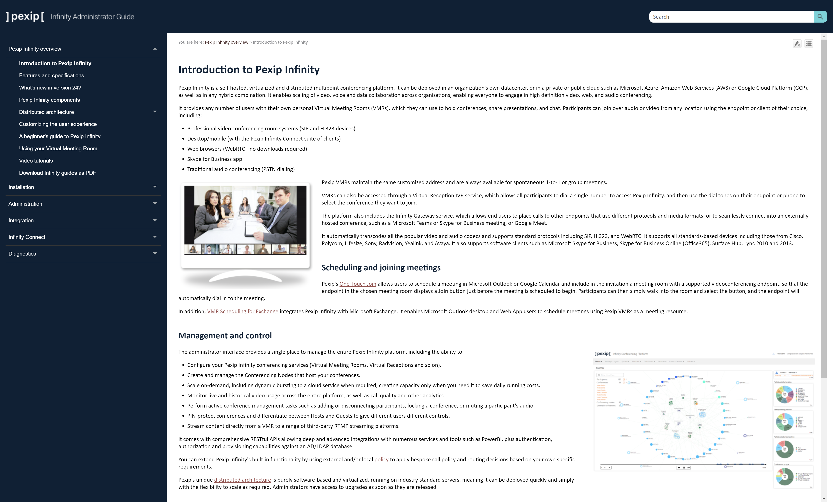
In-built help within the Pexip Infinity Conferencing Platform
Notes:
every Partner has a support toolkit to tap into at his / her fingertips.

Slide 6




Pexip Certified Technology Expert – Troubleshooting & Diagnostics.
Who should attend:
1st line Support Engineer 2nd line Support Engineer
Leve 3 - CTDA eLearning approx. 8 hours.
Program
Using the GUI to analyse and diagnose your Infinity deployment
• Live View – What can be diagnosed, both live and going back in history, through analysing different call types and issues as they show up.
• Alarms – cross-referencing with the Technical documentation and understanding their meaning.
• CDR data - what information is presented and how it can be used to analyse individual calls and conferences.
• Log view summary – to get an overview on individual call issues.
Troubleshooting methodology and raising a 3rd line support request.
Self Hosted Curriculum
Level 4 - CTDE Instructor led and eLearning approx. 2 Days.
Program
Drilling down into logs. 4 hours
Troubleshooting and resolving issues. Working through a simulation of typical 2nd line support issues using the diagnostic tools within the GUI and beyond. 6 hours

Slide 7
Agenda overview
Show then do
Day 1:
Morning :
Lab 1 - Introduction through to deployment – 2.5 hours
Afternoon :
Lab 2 - Interop through to Integration
– 2.5 hours
Day 2:
Morning :
Lab 3 - Media traversal and more integrations
– 2.5 hours
Afternoon:
Lab 4 - Join and UX
– 2 hours

Slide 8

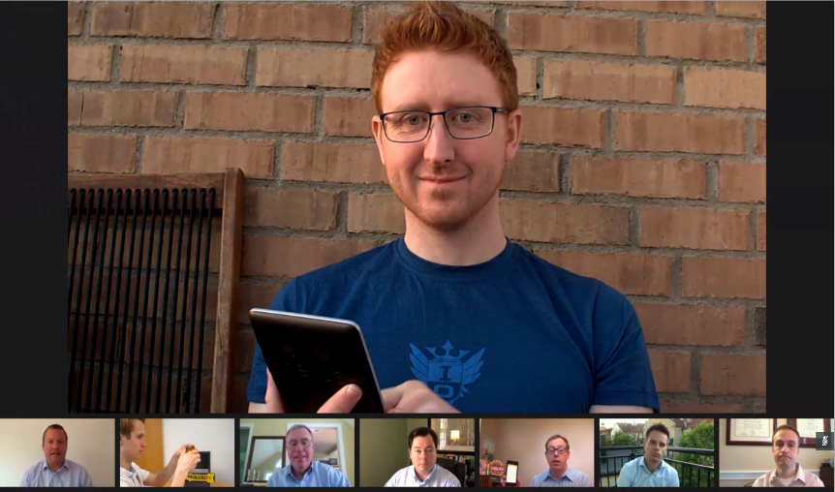
Distributed architecture: Backplanes and licencing
1
2
Scale capacity across multiple physical servers
Scale capacity across geographies
1
6
2
7
3
8
3
A
B
Reduce bandwidth usage through smart media routing
9
4
5
A3
1
4
Share licenses in a global pool – consume when and where needed
1
1
1
1
1
1
1
1
1
1
1
1
1
1
1
1
1
A1
B6
B7
A2
A4
A5
B8
port licenses
Notes:
Pexip’s architecture is unique. As a distributed system, you can deploy multiple software Virtualised Machines (nodes) across many physical servers (hosts), where each node works to add additional call capacity in a given location, and all the nodes act as a single videoconferencing system. Pexip can spread media across three nodes in and single location, for a given service. This takes some getting used to and understanding, and you will likely want to read, and probably re-read, and then re-read again our documentation pages on this.
https://docs.pexip.com/admin/infinity_architecture.htm
https://docs.pexip.com/admin/conference_distribution.htm
https://docs.pexip.com/admin/bandwidth_management.htm
As calls are placed between locations, so Pexip only sends the users streams and resolutions that are required in the remote location. The streams are then combine into a single video mix for the end device, meaning that Pexip can optimise bandwidth usage between those locations. In the layout above (1 + 7), we send one HD stream from the current talker (in location A) and several smaller streams for each of the previous speakers. In this way Pexip would only consume as a maximum of around 3MB of bandwidth between locations (assuming the this is an HD call).
You can deploy many software nodes (these are not charged by Pexip), however, you also need the physical hosts on which they run.
The software and hardware go together to create the “capacity” in order the calls can be placed. However, the licenses “allow” the calls to be placed. The licenses are where you spend your money. Effectively, a port license allows a video connection. In the above conference there are 9 devices connected, so 9 port licenses required. These come from a shared pool, using Pexip’s distributed technology.

Slide 9
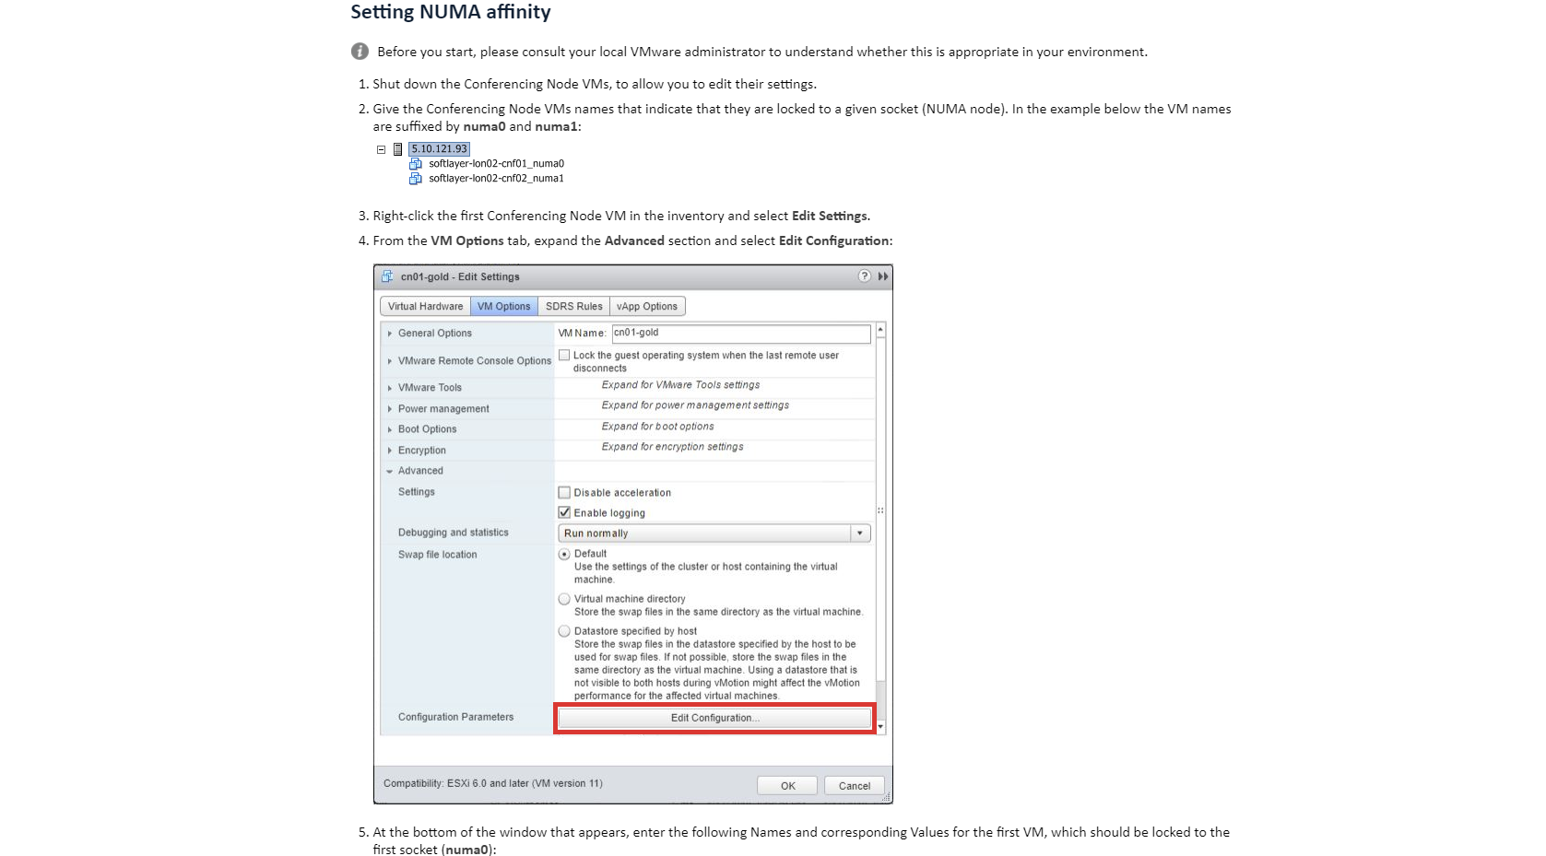
Set-up guidance
https://docs.pexip.com/server_design/vmware_numa_affinity.htm#setting

Slide 10
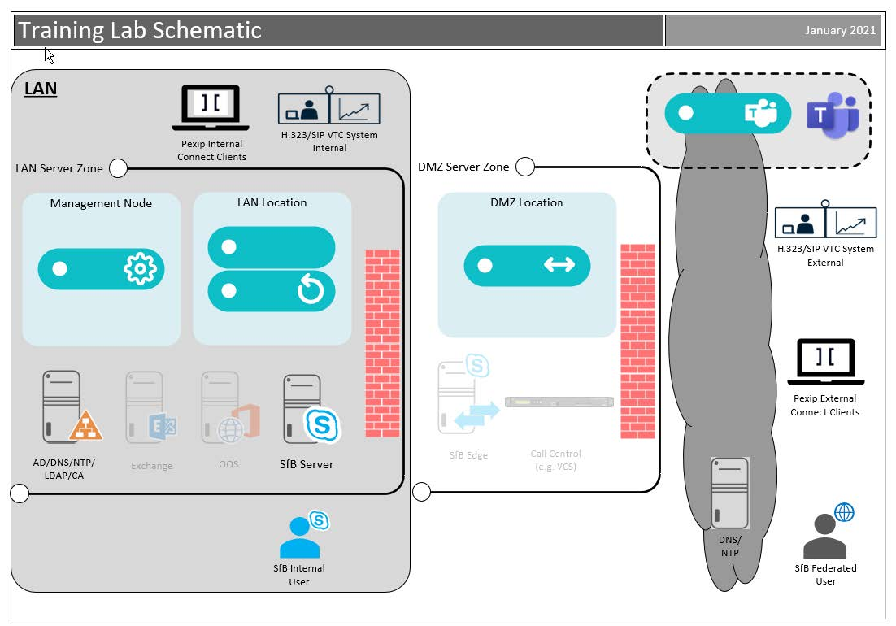
Deployment

Slide 11
Typical real-world redundant deployment
DMZ network zone
Edge Nodes – proxying external calls
4 vCPU / 4 GB RAM / 50 GB disk
Single or dual NIC for internal / external communication
Internal network zone
Transcoding Nodes – transcoding all calls
10+ vCPU / 10+ GB RAM / 50 GB disk
Management Node – managing the platform 4 vCPU / 4 GB RAM / 100 GB disk
Notes:
The components that are used in a typical production system:
https://docs.pexip.com/admin/infinity_components.htm

Slide 12
You lab deployment
DMZ network zone
1 x Edge Node – proxying external calls (initially installed in the Transcoding Role)
4 vCPU / 4 GB RAM / 50 GB disk
Single NIC with Public IP
Internal network zone
2 x Transcoding Nodes – transcoding all calls
4 and 8 vCPU / 4 and 8 GB RAM / 50 GB disk each
Management Node – managing the platform 4 vCPU / 4 GB RAM / 100 GB disk
Notes:
The lab replicates a typical OnPrem deployment, with external Proxying Edge nodes and internal Transcoding nodes plus the Management node.
https://docs.pexip.com/admin/infinity_components.htm

Slide 13

Manually deploying Pexip: all hypervisors
Configure Conf Node
Pexip Mgmt Node (4 vCPU)
Pexip Conf Node (10 vCPU)
Capacity ~20 HD
Pexip Conf Node (6 vCPU) Capacity ~16 HD
Pexip Conf Node (10 vCPU)
Capacity ~20 HD
Pexip Conf Node (10 vCPU)
Capacity ~20 HD
HyperV or VMware
HyperV or VMware
Deploy Conf Node
Dell/IBM/HP/Cisco etc 2x10-core
Dell/IBM/HP/Cisco etc 2x10-core
Download Conf Node
Deploy Mgmt Node
Notes:
As Pexip ONLY runs in a virtualised platform, the first thing you need to do is choose and deploy your hypervisor from our supported list. You can then deploy the different nodes on the hosts, being careful not to over commit your hardware resources (a mistake that is often made in new deployments).
In most cases, you only need to download the management node from the Pexip website. This comes as a VM image file, specific to each hypervisor (e.g. and OVA for VMware – see the slides previously).
You can then configure the basic details of the conferring nodes (such as IP details), and the management node to create an VM image file for you, which you can then deploy to the hypervisor. These are a ONE TIME USE ONLY file, so there is no point in keeping them after the node has been deployed. If you ever need to redeploy a node, even with the same details, you will create a new VM image.
Deploying more nodes means deploying to more hosts.
https://docs.pexip.com/getting_started/decide_deployment_environment.htm
https://docs.pexip.com/admin/hypervisor_support.htm
https://docs.pexip.com/admin/server_design.htm
https://docs.pexip.com/admin/about_software_files.htm

Slide 14
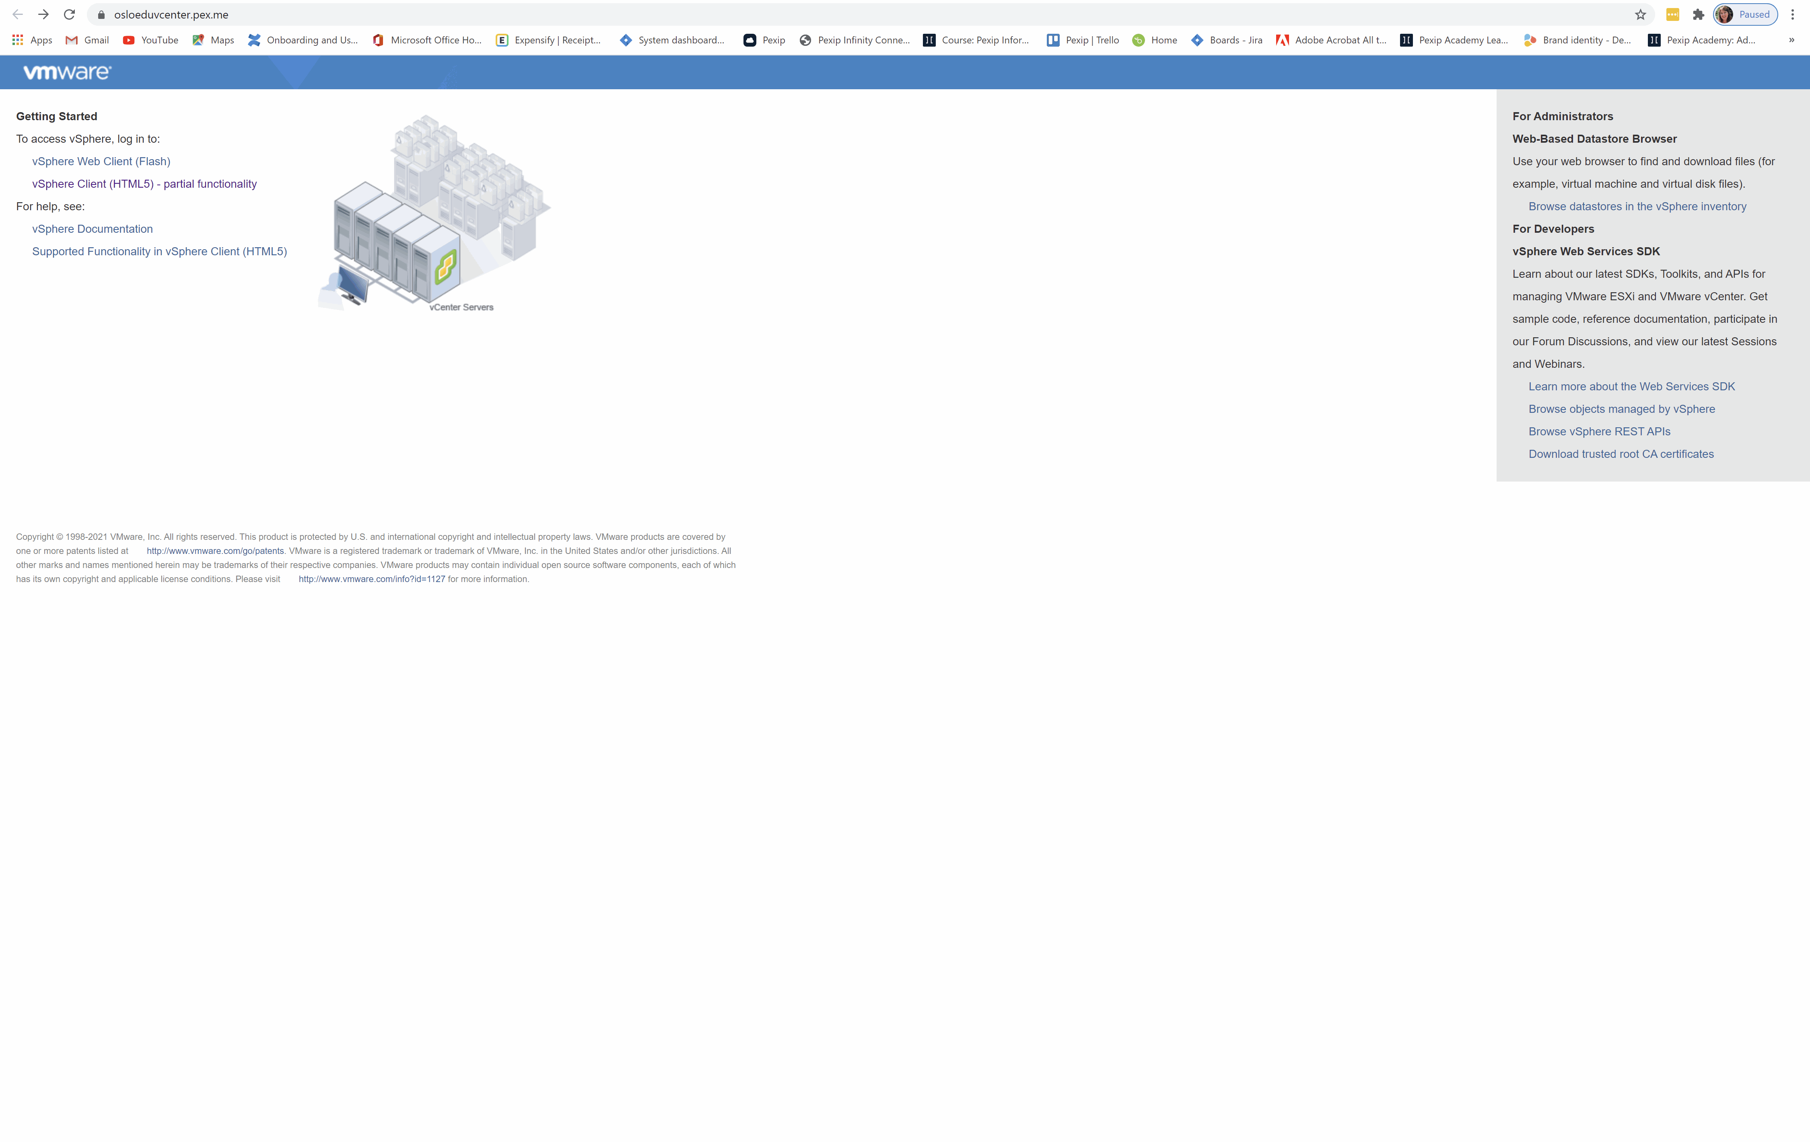

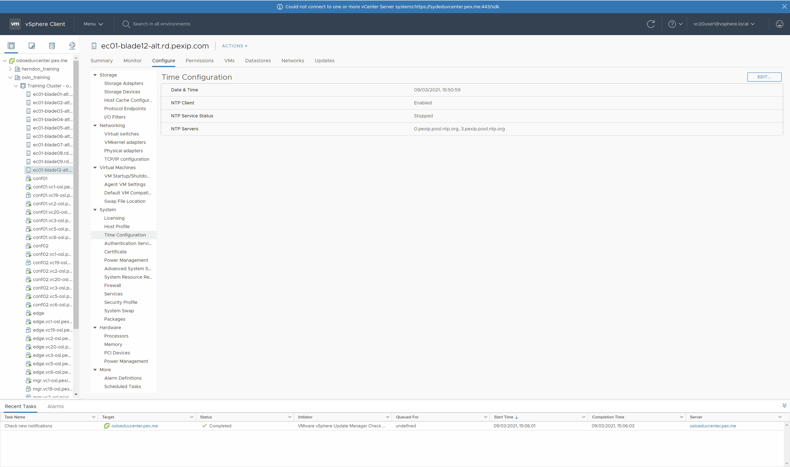
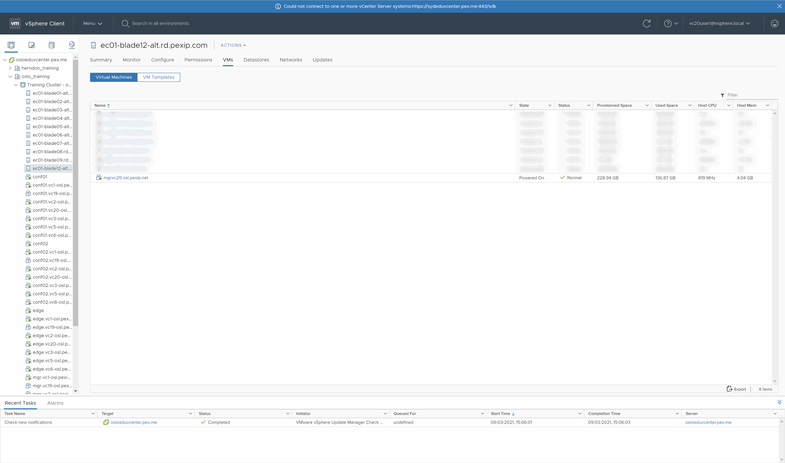
Section 2 1. Deploy the Management Node
Login to the vCenter using the HTML5 client option.
Setting the correct time
Deployment and initial configuration of the Management Node
Demonstrate your working Pexip Infinity deployment
Notes:
Use section #3 and section #4.1 of the lab sheet.
The Management Node is the first component you need to install in an Infinity deployment. It allows you to configure various Pexip Infinity services and integrations with other systems and provides a central point to view both ongoing and historical conferences. It also acts as a syslog server, providing a unified set of logs from all nodes in a deployment, including itself. It doesn’t take part in any conferencing duties, so no media or call signalling will pass through it. Currently, there is only one management node per Pexip Infinity deployment (although this may change in a later version). Every change you make on the management node takes up to 1 minute to replicate to other nodes in the deployment.
Pexip Infinity nodes run in a pure virtualised environment. You can think of a virtualised environment as having two main components:
• The host: this is the physical machine that is used to run the hypervisor.
• The guests: these are Virtual Machines (VMs) that run inside the hypervisor on the host.
In this lab we will use VMware ESXi as the hypervisor, but Pexip can run on many other hypervisors, both OnPrem and in the cloud (such as HyperV, Zen and KVM (all OnPrem), or Azure, GCP and AWS (in the cloud))

Slide 15
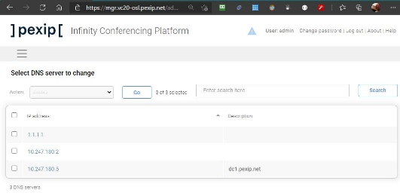
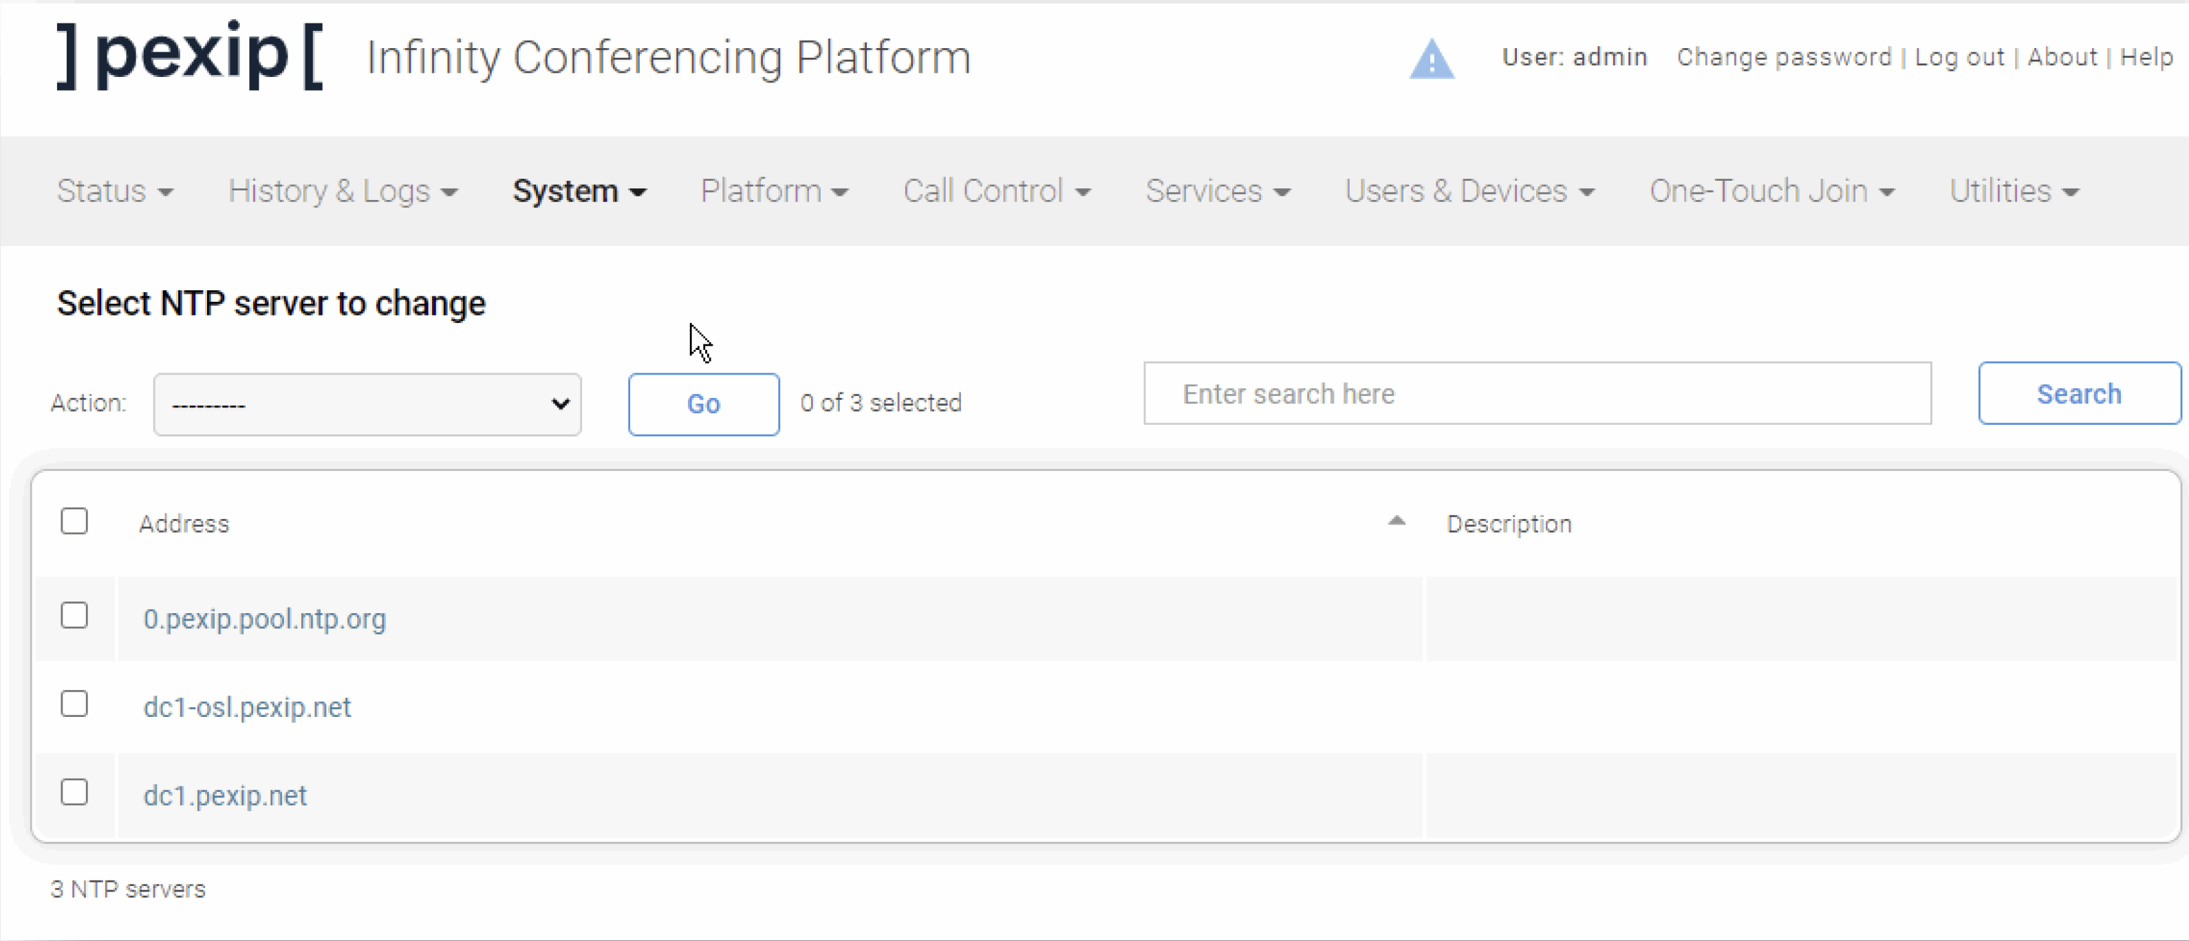
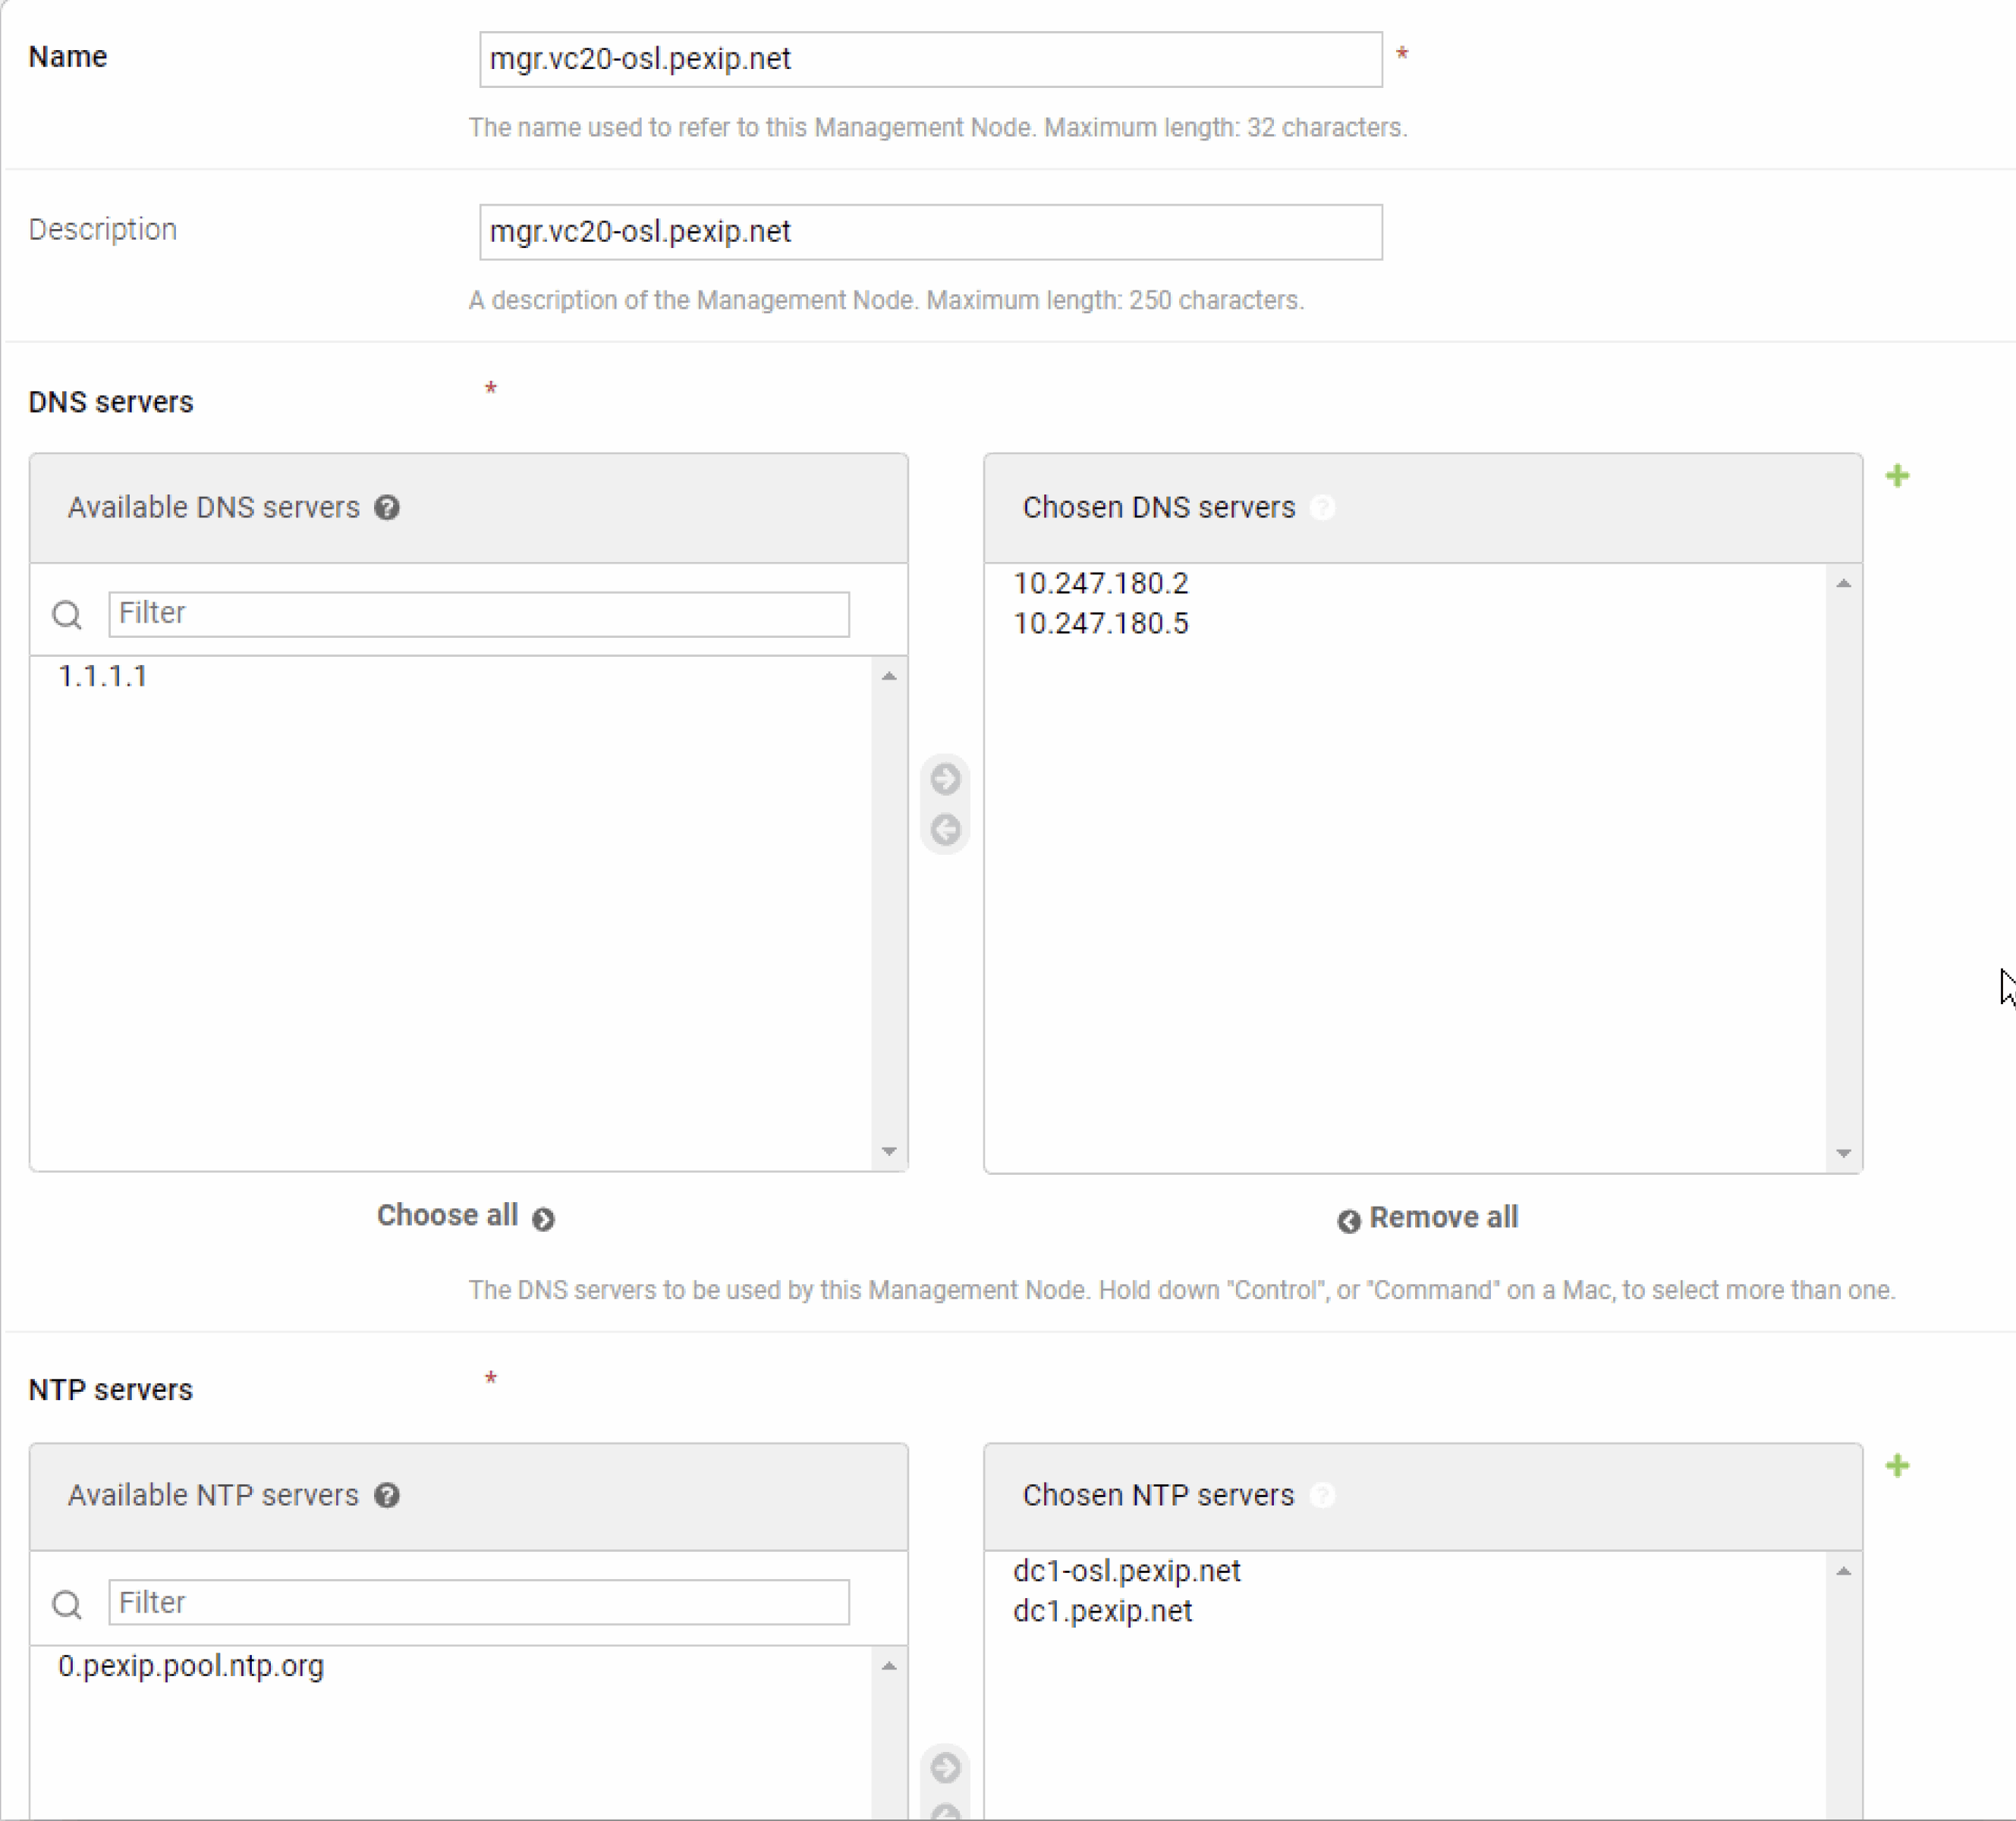

Section 2 2. Configure locations
DNS for the system
NTP for the System
DNS & NTP for mgr node
Demonstrate your working Pexip Infinity deployment
Notes:
Use section #3 and section #4.1 of the lab sheet.
The Management Node is the first component you need to install in an Infinity deployment. It allows you to configure various Pexip Infinity services and integrations with other systems and provides a central point to view both ongoing and historical conferences. It also acts as a syslog server, providing a unified set of logs from all nodes in a deployment, including itself. It doesn’t take part in any conferencing duties, so no media or call signalling will pass through it. Currently, there is only one management node per Pexip Infinity deployment (although this may change in a later version). Every change you make on the management node takes up to 1 minute to replicate to other nodes in the deployment.
Pexip Infinity nodes run in a pure virtualised environment. You can think of a virtualised environment as having two main components:
• The host: this is the physical machine that is used to run the hypervisor.
• The guests: these are Virtual Machines (VMs) that run inside the hypervisor on the host.
In this lab we will use VMware ESXi as the hypervisor, but Pexip can run on many other hypervisors, both OnPrem and in the cloud (such as HyperV, Zen and KVM (all OnPrem), or Azure, GCP and AWS (in the cloud))

Slide 16

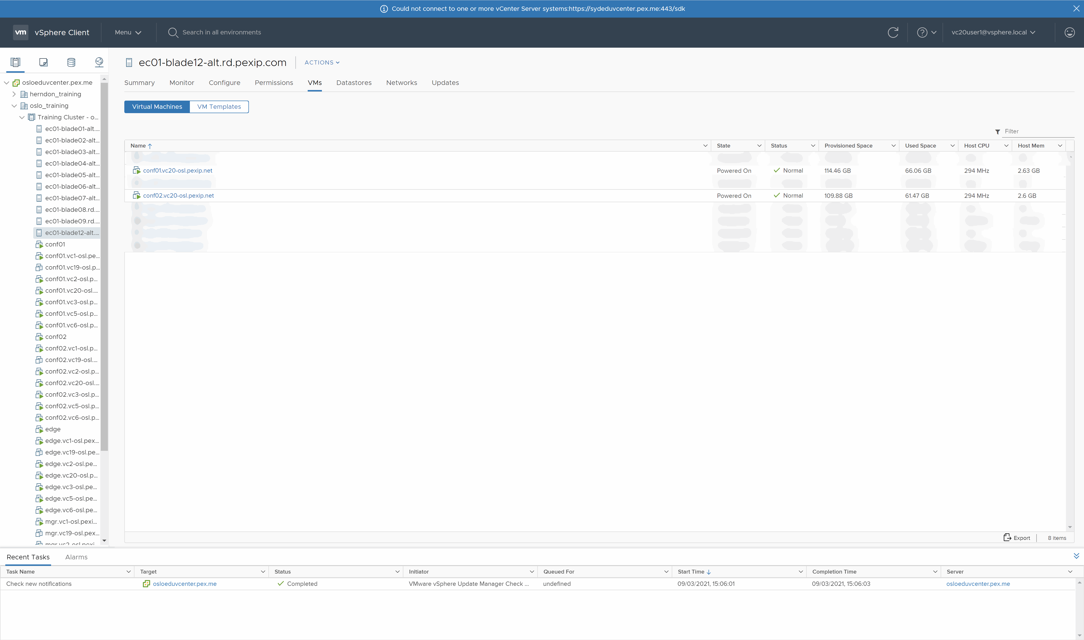
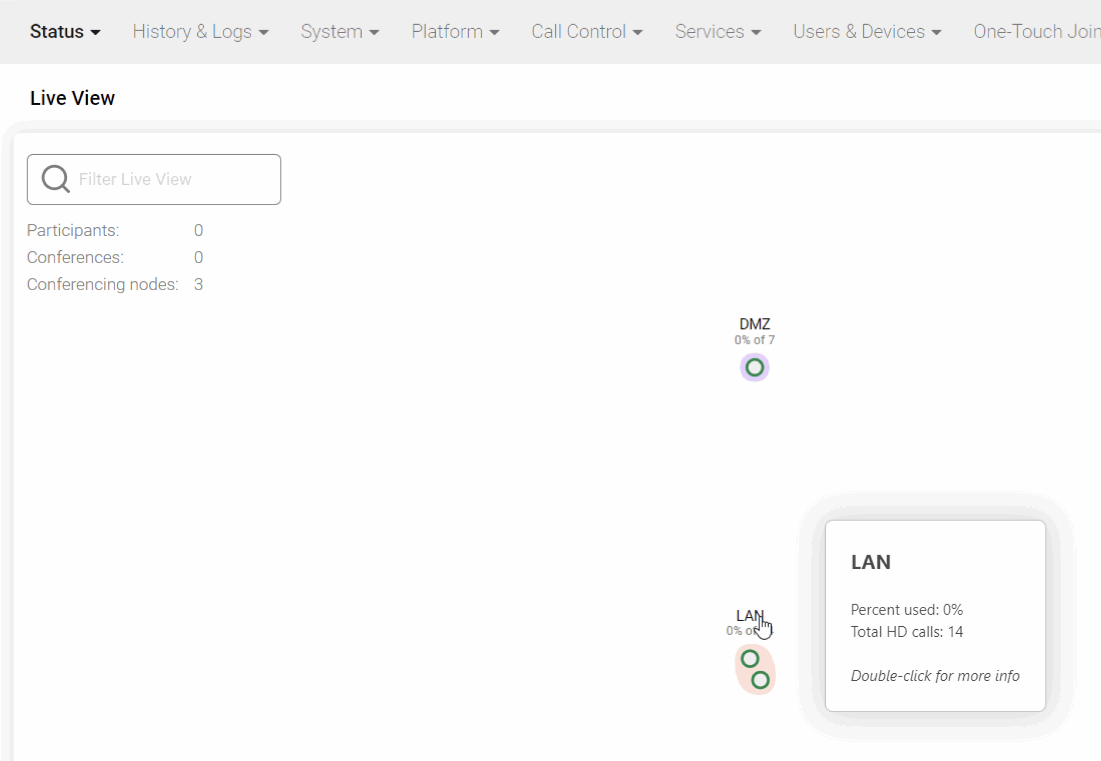
Section 2 3. Deploy Internal Pexip Transcoding Conferencing Nodes.
Each Node also has a host name:
mgr
conf01
edge
Deploy Internal Pexip Transcoding nodes x 2 (LAN)
Demonstrate your working Pexip Infinity deployment
Notes:
Use section #3 and section #4.1 of the lab sheet.
The Management Node is the first component you need to install in an Infinity deployment. It allows you to configure various Pexip Infinity services and integrations with other systems and provides a central point to view both ongoing and historical conferences. It also acts as a syslog server, providing a unified set of logs from all nodes in a deployment, including itself. It doesn’t take part in any conferencing duties, so no media or call signalling will pass through it. Currently, there is only one management node per Pexip Infinity deployment (although this may change in a later version). Every change you make on the management node takes up to 1 minute to replicate to other nodes in the deployment.
Pexip Infinity nodes run in a pure virtualised environment. You can think of a virtualised environment as having two main components:
• The host: this is the physical machine that is used to run the hypervisor.
• The guests: these are Virtual Machines (VMs) that run inside the hypervisor on the host.
In this lab we will use VMware ESXi as the hypervisor, but Pexip can run on many other hypervisors, both OnPrem and in the cloud (such as HyperV, Zen and KVM (all OnPrem), or Azure, GCP and AWS (in the cloud))

Slide 17

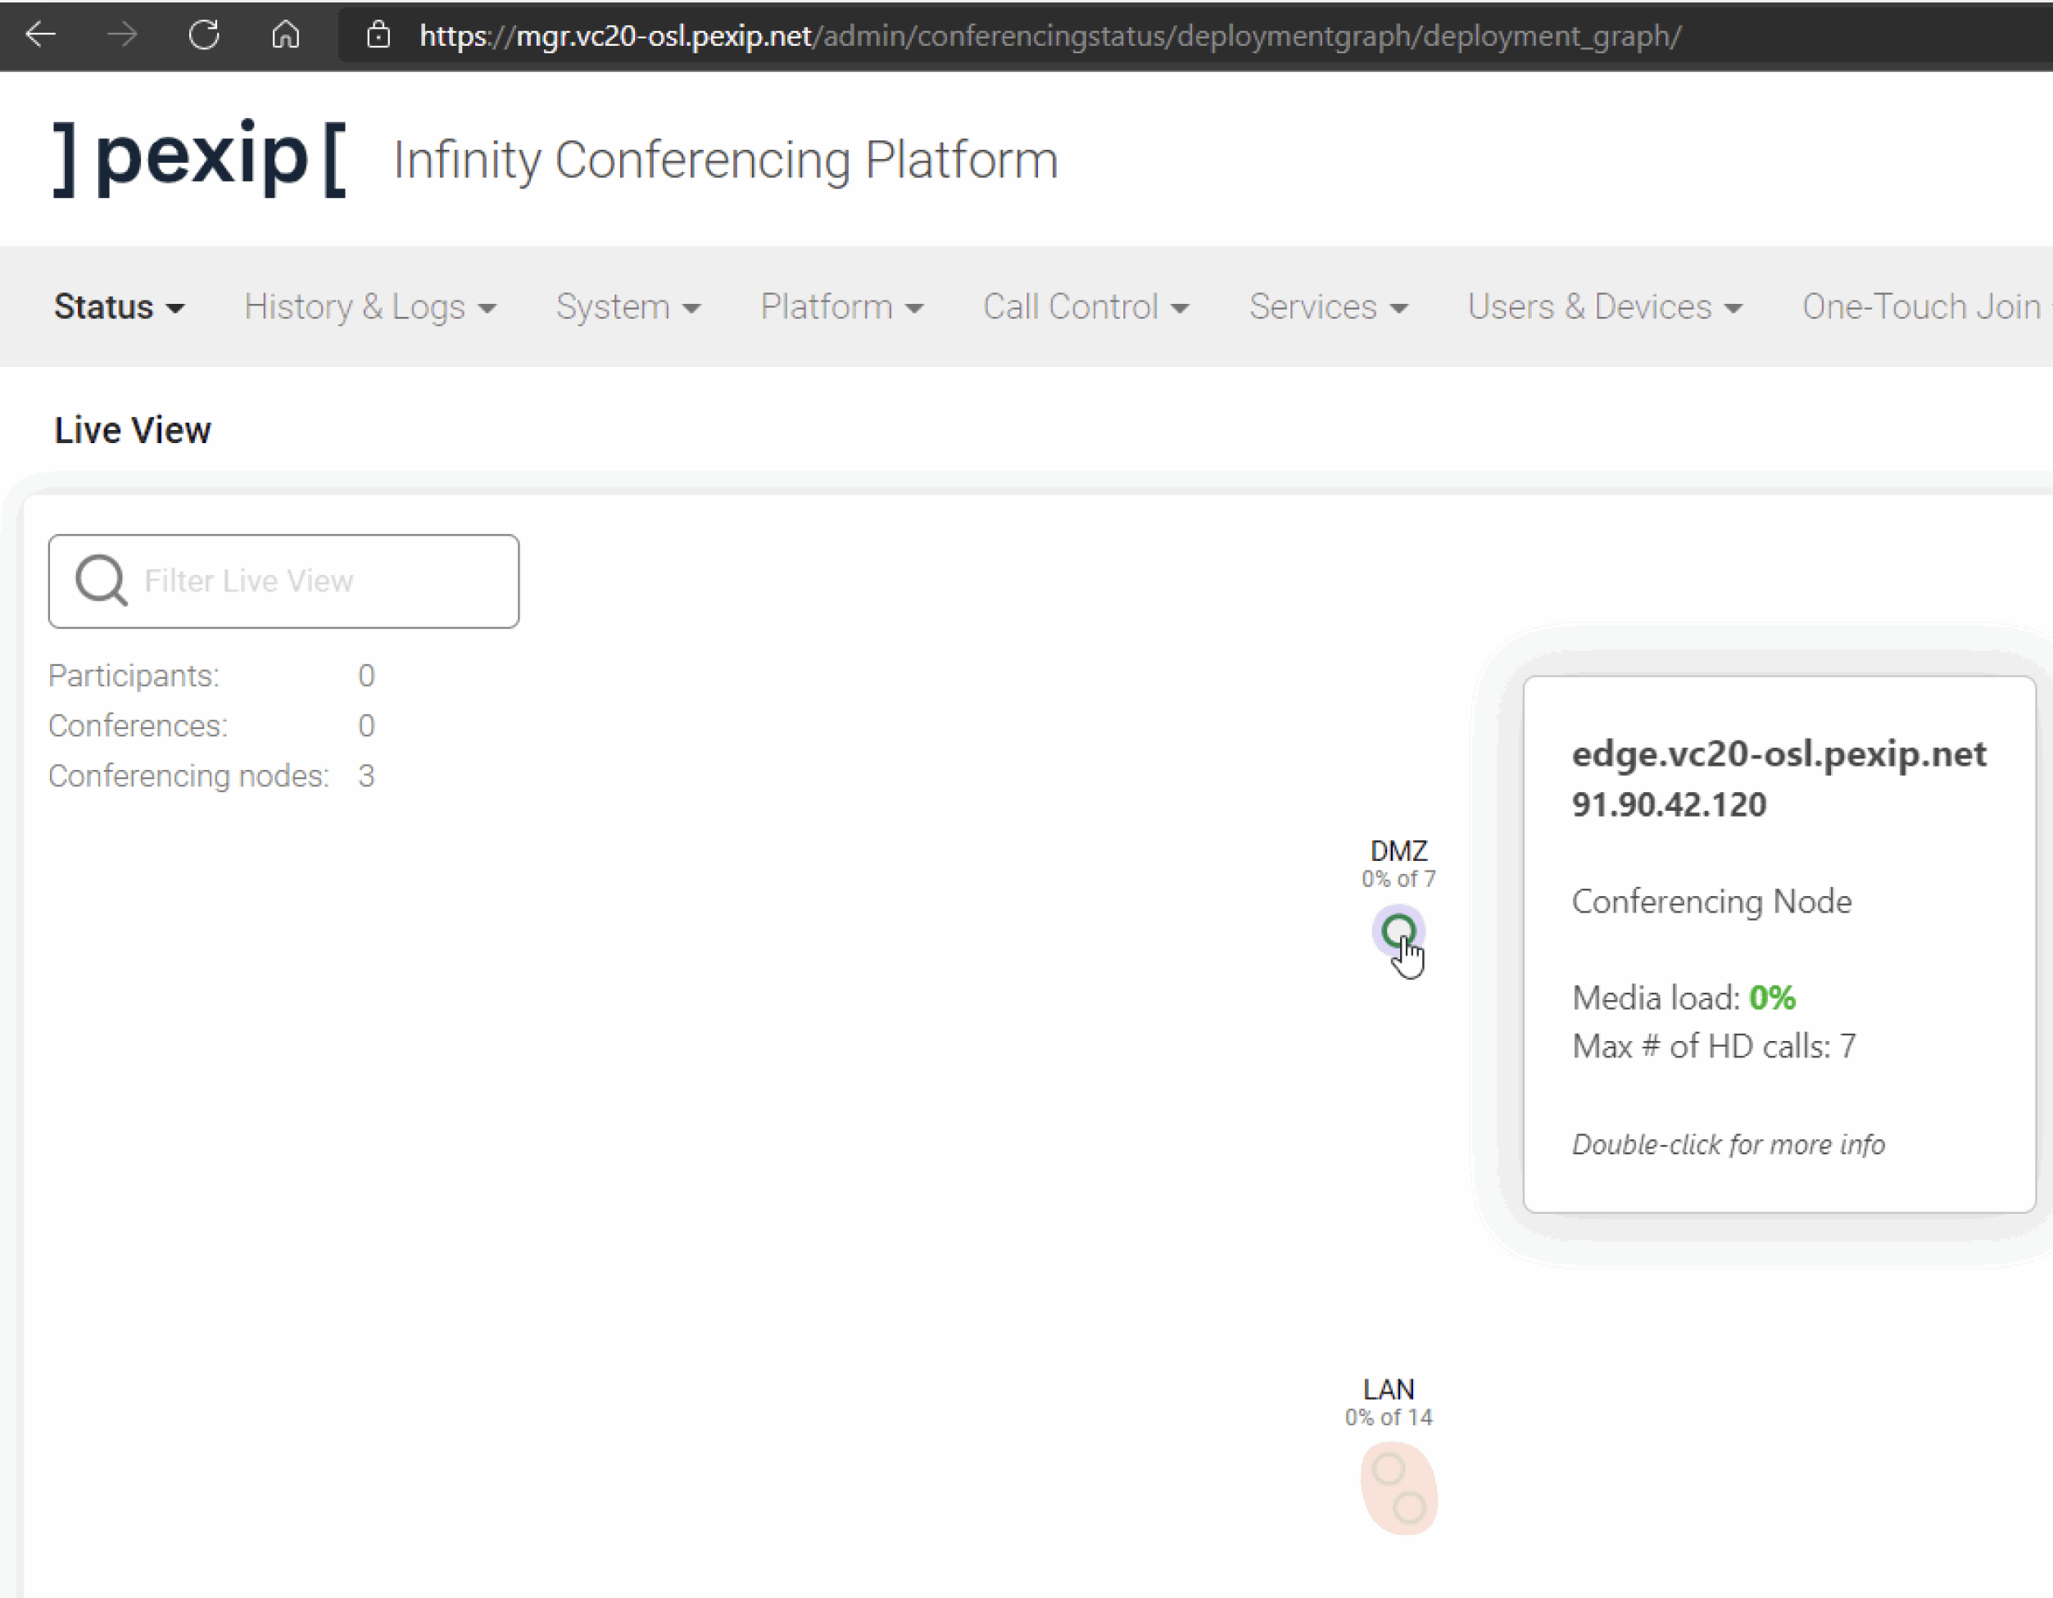
Section 2 4. Deploy External Conferencing Node ( just in the Transcoding Role).
Deploy External Conferencing Node (just in the Transcoding Role).
Demonstrate your working Pexip Infinity deployment.
Notes:
Use section #3 and section #4.1 of the lab sheet.
The Management Node is the first component you need to install in an Infinity deployment. It allows you to configure various Pexip Infinity services and integrations with other systems and provides a central point to view both ongoing and historical conferences. It also acts as a syslog server, providing a unified set of logs from all nodes in a deployment, including itself. It doesn’t take part in any conferencing duties, so no media or call signalling will pass through it. Currently, there is only one management node per Pexip Infinity deployment (although this may change in a later version). Every change you make on the management node takes up to 1 minute to replicate to other nodes in the deployment.
Pexip Infinity nodes run in a pure virtualised environment. You can think of a virtualised environment as having two main components:
• The host: this is the physical machine that is used to run the hypervisor.
• The guests: these are Virtual Machines (VMs) that run inside the hypervisor on the host.
In this lab we will use VMware ESXi as the hypervisor, but Pexip can run on many other hypervisors, both OnPrem and in the cloud (such as HyperV, Zen and KVM (all OnPrem), or Azure, GCP and AWS (in the cloud))

Slide 18
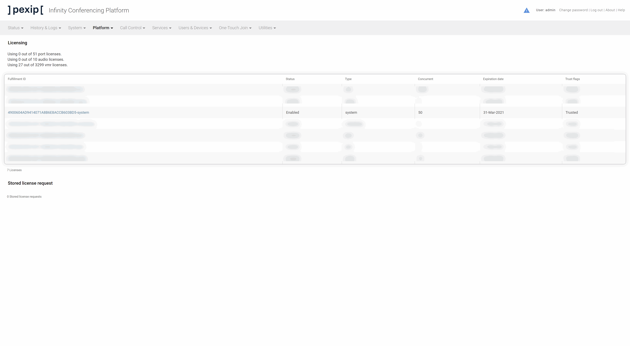
Section 2 5. Activate the Pexip Licenses.
Activate the Pexip Infinity Licence.
Demonstrate you have a fully licenced.

Slide 19
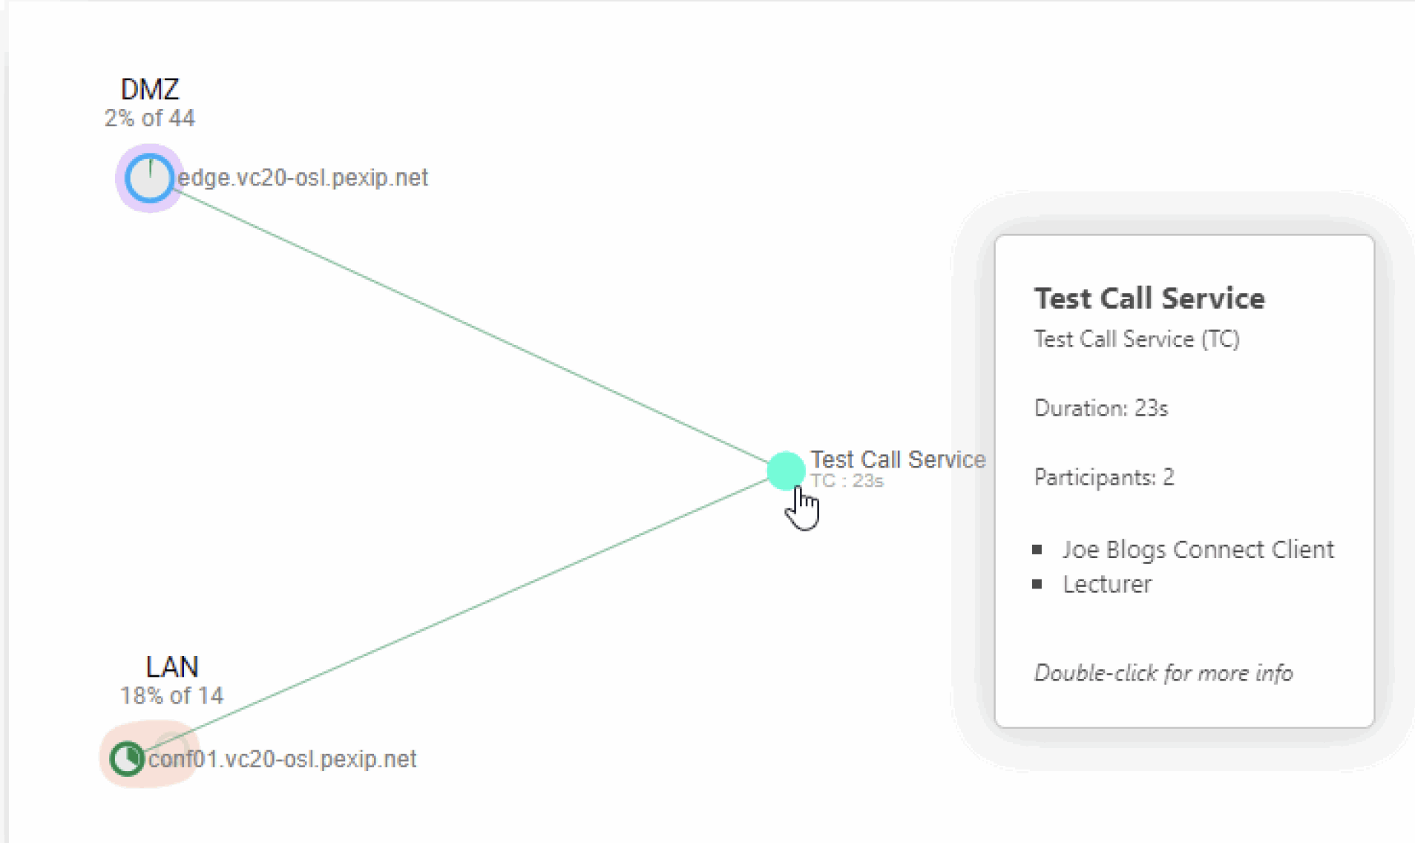
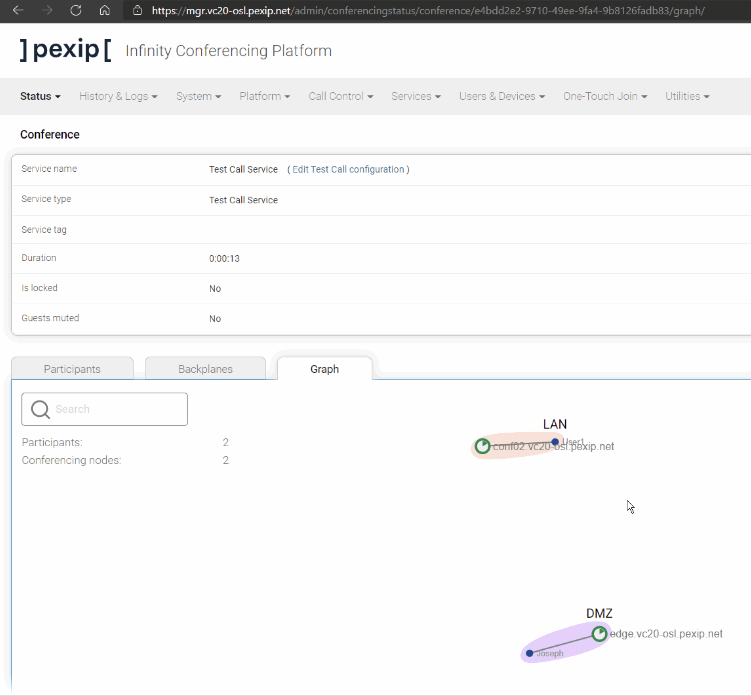
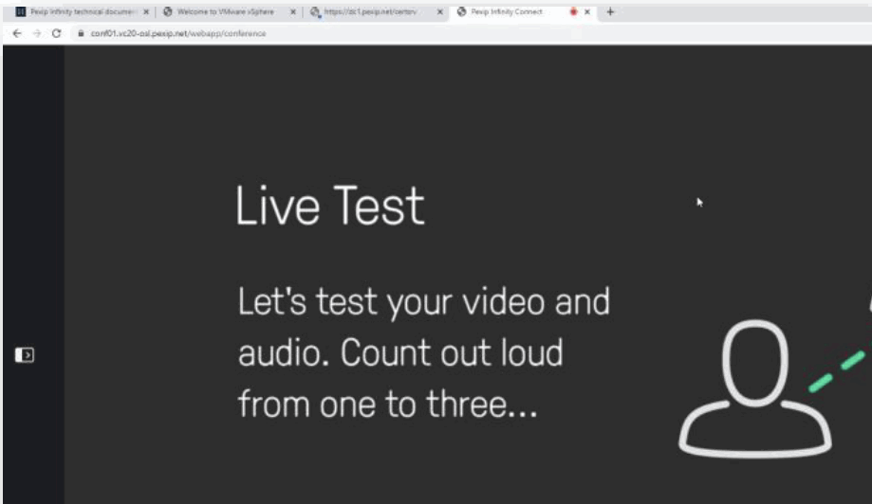
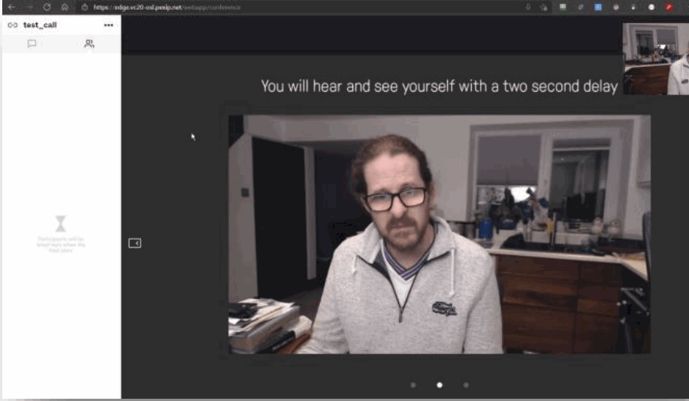
Section 2 6. Create a Test Call Service
Create a Test Call Service
Test and demonstrate your test calls.

Slide 20
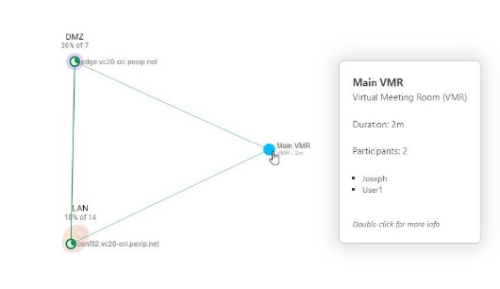
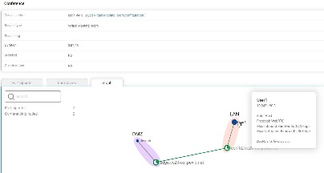
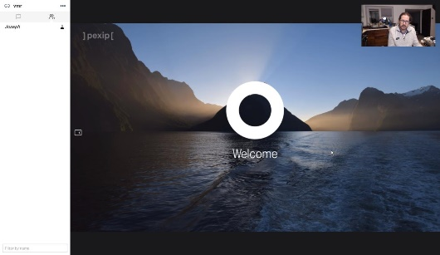
Section 2 7. Create a Virtual Meeting Room (with no PIN).
7.1 Create a VMR with no pin.
7.2 Test
7.3 Demonstrate your test calls.
7.4 Upload all your screenshots to the LMS using the template for Lab 1

Slide 21
Lab 2 Interop through to integration
Section 1 Switching from a Transcoding Edge Node to a Proxying Edge Node
Section 2 TLS Certificates
Section 3 Create a Virtual Auditorium
Section 4 Create a Virtual Meeting Room
Section 5 Create a Virtual Reception (Lobby / IVR)
Section 6 Infinity Connect Client Registration and Gateway P2P call

Slide 22
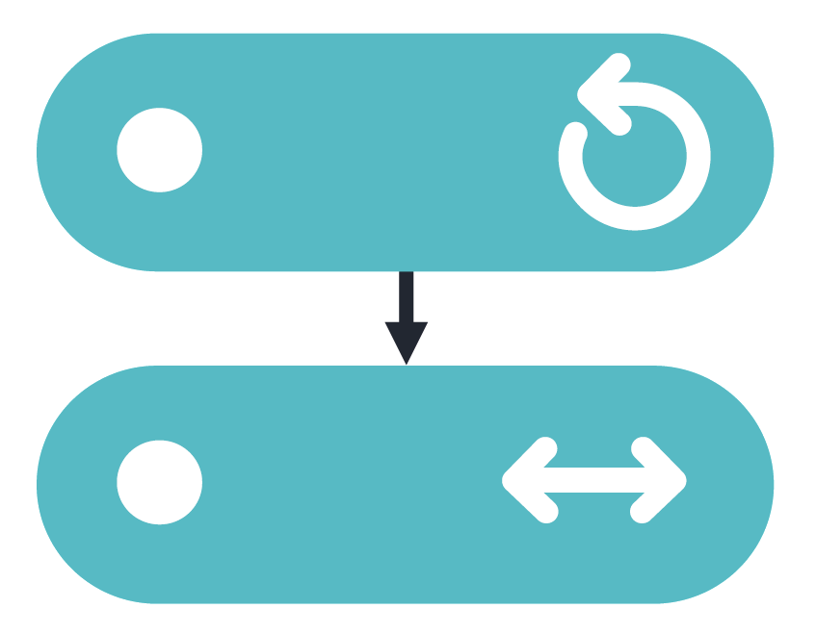
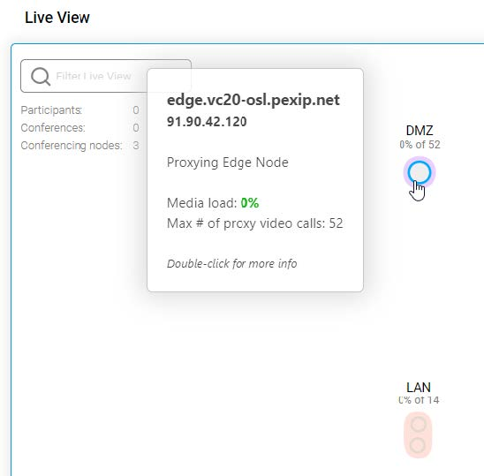
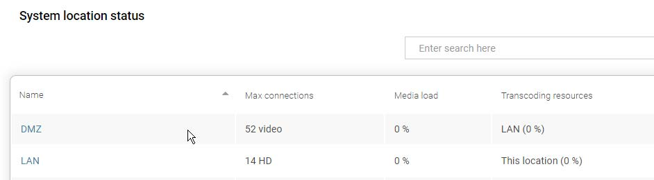
Section 1 1. Switching from a Transcoding Edge Node to a Proxying Edge Node
1.1 Switch from a Transcoding Edge Node to a Proxying Edge Node
1.2 Test
1.3 Demonstrate how to successfully configure Pexip Infinity Services

Slide 23
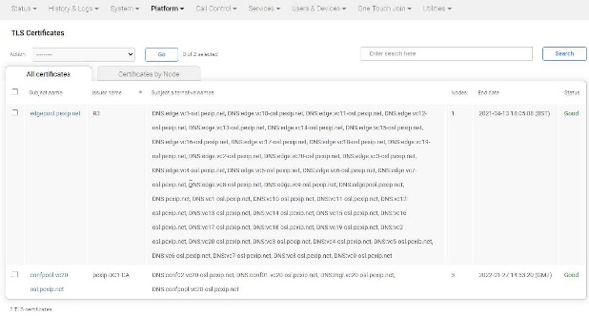
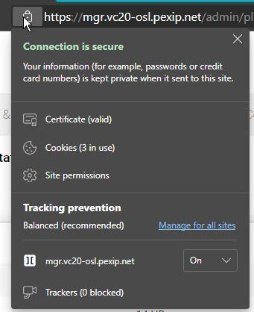
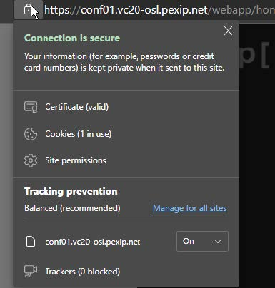
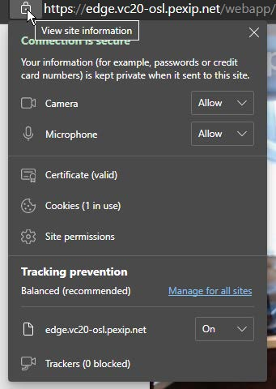
Section 2 2. TLS Certificates
2.1 Create TLS certificate for internal Transcoding Conferencing Nodes
2.1.1 Generate a CSR on Pexip Infinity
2.1.2 Creating the internal certificate
2.1.3 Complete the signing request and assign the certificate in the Pexip Infinity deployment
2.2 Upload the internal CA root certificate
2.3 Create a TLS certificate for external Proxying Edge Node
2.3.1 Using a third-party Certificate Authority via a self- generated PEM certificate bundle
2.4Removing ALL temporary certificates
2.5 Test
2.6 Demonstrate how to successfully configure Pexip Infinity Services

Slide 24
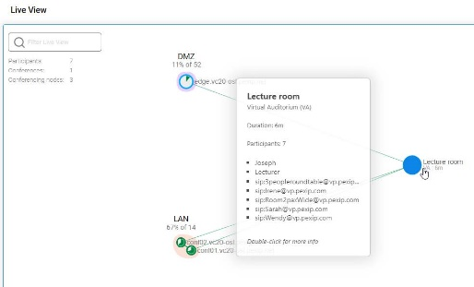

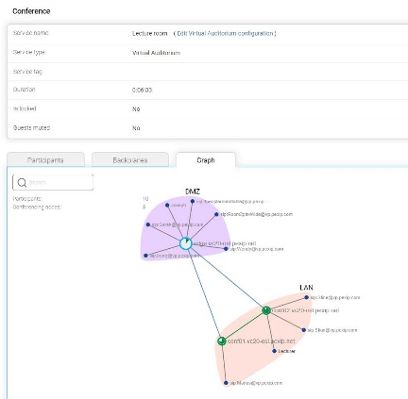
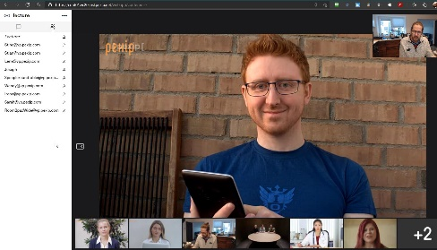
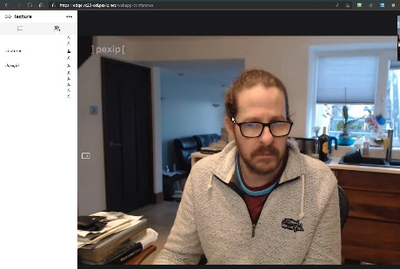
Section 3 3. Create a Virtual Auditorium
Challenge
3.1 Create a Virtual Auditorium for hosts and guests, ensure that you have set a Host PIN and “Allow guests” is set to “Yes”.
3.2 Test
Pexip EndPoints PexEPs.
Internal (LAN):
http://10.247.180.6/gui/ - SD
http://10.247.180.7/gui/ - HD
External (DMZ):
US: http://us-pexep.pex.me
Europe: http://no-pexep.pex.me
Australia: http://au-pexep.pex.me
3.3 Demonstrate how to successfully configure Pexip Infinity Services

Slide 25
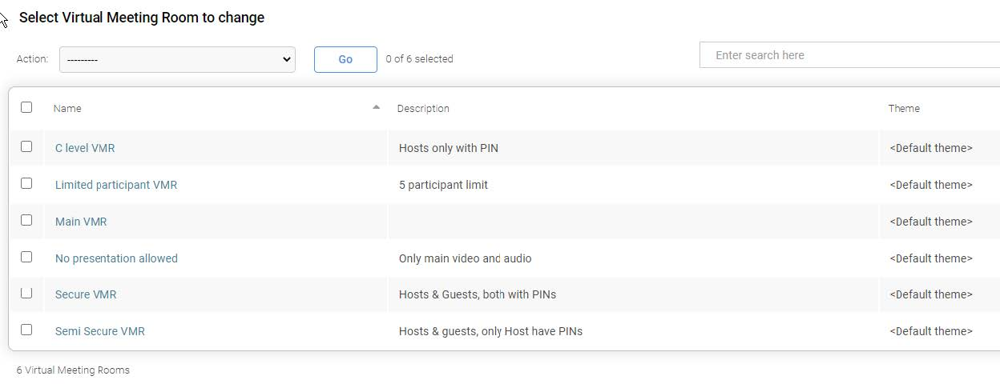
Section 4 4. Create a series of Virtual Meeting Room
4.1 Create a secure VMR to allow some users to manage the conference
4.2 Create a semi-secure VMR allowing easy access for guests
4.3 Create a secure VMR only for C level users
4.4 Create a VMR to show two main speakers but do not allow presentation
4.5 Create a VMR to show participant names and limit the room capacity to 3
4.6 Test (PexEPs)
4.7 Demonstrate how to successfully configure Pexip Infinity Services

Slide 26
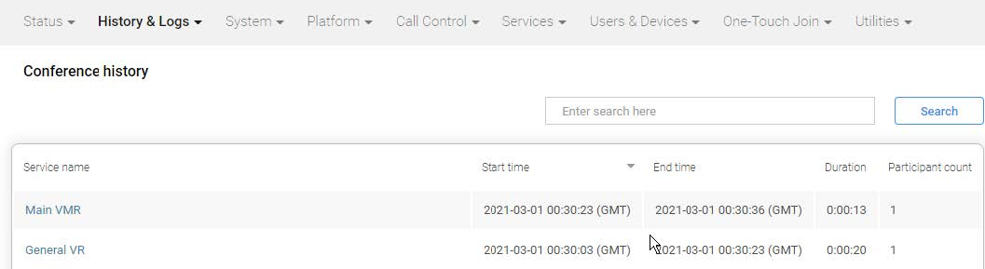
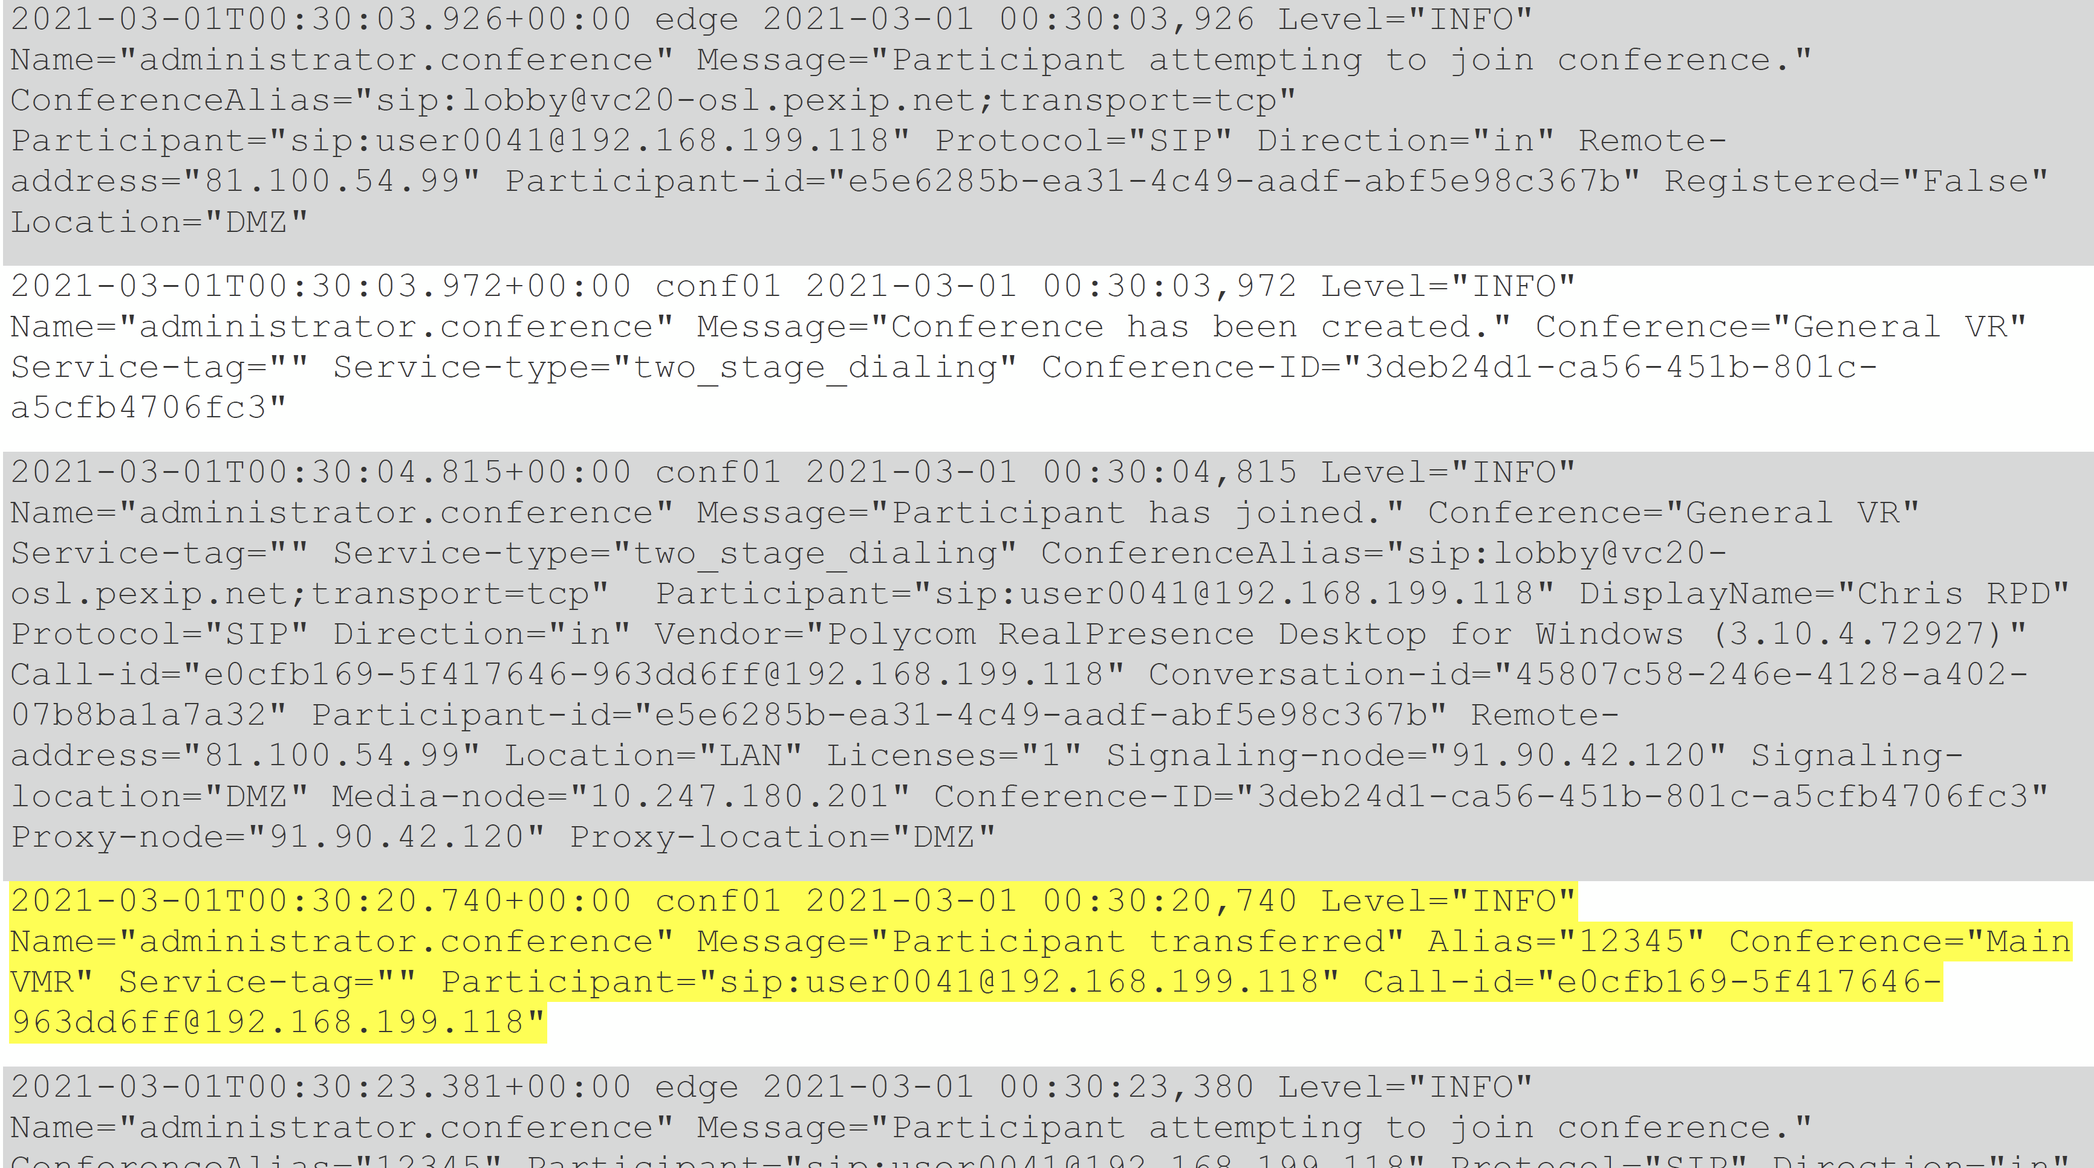
Section 5 5. Create a Virtual Reception (Lobby / IVR)
5 Create a ‘General VR’ with a second alias as a numeric
5.2 Test
5.3 Demonstrate how to successfully configure Pexip Infinity Services
See Administrator Logs

Slide 27
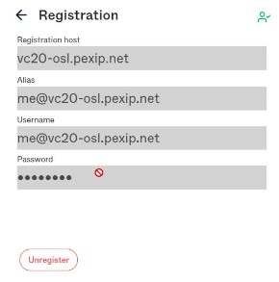
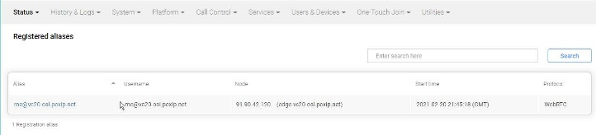
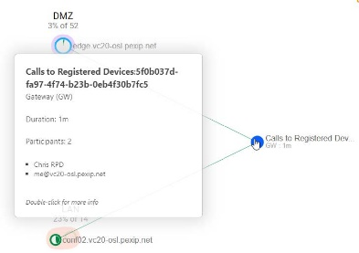
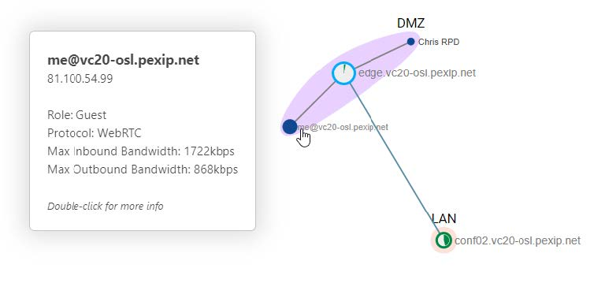
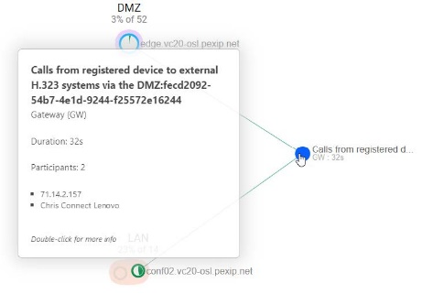
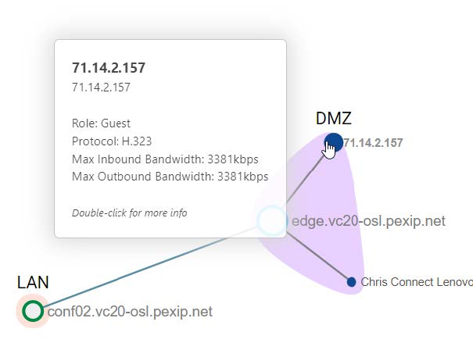
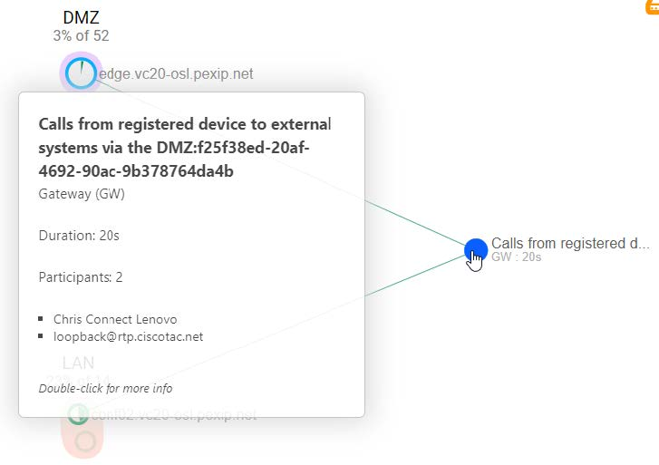
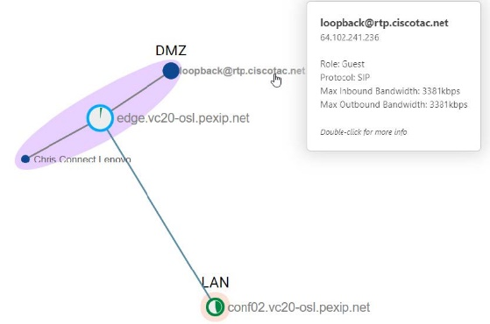
Section 6 6. Infinity Connect Client Registration and Gateway P2P call
6.1 To register a device, configure Infinity to accept the registration
6.2 Configure the Connect client to register to Infinity
6.3 Add Routing Rules
6.4 Test
6.5 Grab some screenshots of the registered devices and status in Infinity
6.7 Upload all saved screenshots from today’s session to the LMS in the template provided.

Slide 28
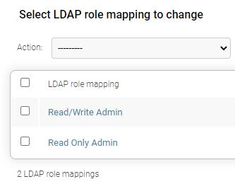


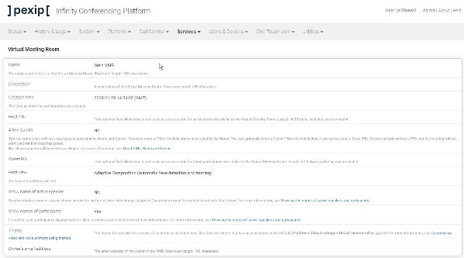
Section 7 7.Enable LDAP management login authentication
1.1 Configure LDAP Authentication
1.2 Test
2.3 Demonstrate your ability to administer a Pexip Infinity system

Slide 29

Home-time Day 1!
Well done, you have successfully
Configure Pexip Management Nodes and Pexip Conferencing Nodes
Demonstrate product use and administrator tasks

Slide 30




Day 2
Agenda:
Recap
Tasks for today
Next Steps

Slide 31

Lab 3 Media traversal and more integrations – 2.5 hours
Section 1 Google Meet Integration
Section 2 Microsoft Teams Integration
Section 3 IVR and Audio / PSTN Connectivity
(Extra Credit)
Section 4 Skype for Business Integration

Slide 32







Section 1 1. Google Meet Integration
1.1 log into the Google Admin portal (https://admin.google.com/),
1.1.1Navigate to YOUR GROUP’S OU.
i.e VC01
1.1.2 Interoperability: You need to enable interoperability for your group (or Organisational Unit)
1.1.3 Configure 2 Gateways for interoperability:
trusted & untrusted devices are required
Generate Token for Infinity
1.1.4 Configure the Google Meet settings using the RDP session
1.2 Login to GUI
1.2.1 Add 2 Google Licences for each token
1.2.2 Add 2 different call routing rules
1.3 Test
1.4 Demonstrate how to configure the Pexip Infinity system with a 3rd party integrations.

Slide 33






Section 2 2. Microsoft Teams Integration
2.1 Configure your Pexip Infinity deployment with the integration details of the Teams connector
2.2 Setup Pexip to act as a gateway to Teams
2.2.1 VR
2.2.2 Routing Rules
2.3 Test

Slide 34

Section 3 IVR and Audio / PSTN Connectivity
Challenge
3. Demonstrate how to configure IVR and Audio / PSTN Connectivity
3.1 Test
3.2 Demonstrate how to configure the Pexip Infinity system with a 3rd party integrations
3.3 Upload all your screenshots to the LMS using the template provided for Lab 3.
(Extra Credit)
Section 4 Skype for Business Integration

Slide 35
Lunch-time!
Well done, you have now successfully
Configure Pexip Management Nodes and Pexip Conferencing Nodes
Demonstrate product use and administrator tasks
Identify integration capabilities in Pexip solutions

Slide 36
Lab 4 Join and user experience - 2.5 hours
Section 1 Configure and Activate Pexip Smart Scale
Section 2 Upgrading Pexip
Section 3 Customizing the user experience (UX)
(Extra Credits)
Section 4 LDAP VMR Sync/Import
Section 5 NUMA Pinning
Section 6 Upgrade and test a beta version

Slide 37


Section 1 1 Configure and Activate Pexip Smart Scale
1.1 Enable PSS
1.2 Create a System Location to contain the PSS nodes
1.3 Configure PSS location
1.4 Configure the DMZ System location
1.5 Configure the LAN System location
1.6 Test
1.7 Demonstrate your ability to administer a Pexip Infinity system

Slide 38





Section 2 1. Upgrading Pexip
1.1 Upgrading Pexip
1.2 Test
1.3 Demonstrate Pexip has been upgraded
1.4 Remove snapshots

Slide 39





Section 3 1. Customizing the user experience (UX)
1.1 Build asset files in NextGen Portal
1.2 Demonstrate your ability to customise Infinity by showing a customised WebApp landing page, including a subtle corporate logo.
1.2.1 Test
1.3 Demonstrate your ability to customise Infinity by showing a customised in-conference experience, including a subtle corporate logo. (Welcome screen)
1.3.1 Test
1.4 Upload all the screenshots to the LMS using the template for Lab 4
Peer review & Self Assessment.
(Extra Credits)
Section 4 LDAP VMR Sync/Import
Section 5 NUMA Pinning
Section 6 Upgrade and test a beta version

Slide 40

Wow! You done it!
Let’s Reflect -
What?
How?
Why?

Slide 41
Agenda overview - eLearning, Clinic & Assessment
Theory & Assessment
eLearning Modules:
One Touch Join
On-line module
– approx. 2 hours
Clinic:
Live, virtual forum to discuss items from the course and cover some more theory behind installing and configuring Infinity.
– ½ Day
Final Assessment:
A series of on-line, self-paced quizzes to ensure understanding and that your learning objectives have been met
- approx. 2 hours

Slide 42
Home-time!
Well done, you have now successfully completed all course objectives
Configure Pexip Management Nodes and Pexip Conferencing Nodes
Demonstrate product use and administrator tasks
Identify integration capabilities in Pexip solutions
Identify the communication technologies supported by Pexip Infinity
Knowledge Empowers

Slide 43
Takeaways

Slide 44

Docs.Pexip.com
https://docs.pexip.com/admin/download_pdf.htm#admin

Slide 45





Next Steps
CTE Diagnostics – July 2022
Live Virtual Clinics (optional) – 4 hours
Final Assessment – LMS

